Slide 1

Teaching Seminar
Clinical Assistant or Associate Professor in Online Education Candidate
Shaping the Future of Online Education:
A Game Design Perspective
Welcome! Please come on in and have a seat.
This live performance is part of the teaching demonstration.
Dr. Yaguang Zhang
May 5, 2023 | 10:30-11:30 AM EDT
1
Notes:
Sorry about the confusion. I always feel awkward standing in the front of the room waiting for my talk to start, so I thought it may be a good idea to do something fun this time while we wait.
Besides, the performance was more than “just for fun”. It was recorded and will be used as the raw materials for a part of the teaching demonstration that we will cover later today, tailored for the example topic, digital signal processing.
Now that we have the needed audio clip, I will stay quiet and wait for the signal to start the seminar… unless we have any questions about the song or the recording. Hopefully, more people will join us.

Slide 2
Teaching Seminar by Clinical Assistant or Associate Professor in Online Education Candidate
Shaping the Future of
Online Education:
A Game Design Perspective
Dr. Yaguang Zhang
May 5, 2023
Notes:
Good morning! I am Dr. Yaguang Zhang, a postdoc at Purdue University. Thank you very much for joining us.
Today we will have a very interesting discussion on how, we educators, may improve student involvement in online education, with the help of game design techniques.
In my opinion, attractiveness, or more aggressively, “addictiveness”, is the most important feature that is missing in today’s mainstream online courses. Adding that into the equation will definitely help students spend more time learning and developing the skills that we want them to master. This explains a little bit about the title: Shaping the Future of Online Education: A Game Design Perspective.

Slide 3

Shaping the Future of Higher Education? Becoming a Land-grant University for Our Times
3
Notes:
Just 2 weeks ago, while I was preparing this talk, Professor Jay Akridge gave a James Snyder Memorial Lecture at Purdue about higher education. I was lucky enough to attend the talk, and that was easily one of my most unique lecture experiences, because I never expected before: a lecture could be so encouraging and discouraging at the same time.
Why was it encouraging to me? Well, I first got the news about this in an email. The title I saw there literally gave me a shiver running up my spine: Shaping the Future of Higher Education? Becoming a Land-grant University for Our Times.

Slide 4
Shaping the Future of Higher Education? Becoming a Land-grant University for Our Times
Shaping the Future of Education as a Pioneering Institute
4
Notes:
At that time, the tentative title for this talk was: Shaping the Future of Education as a Pioneering Institute. What a coincidence! I did not even know Dr. Akridge before his lecture. But his lecture was featured at the university level, so this topic must be worth talking about!

Slide 5
Shaping the Future of Higher Education? Becoming a Land-grant University for Our Times
Shaping the Future of Education as a Pioneering Institute
Encouraging 😃
Title
5
Notes:
That was very, very encouraging.
Then I went to his talk and got to know Dr. Akridge a little more. Apparently, he is a big shot. Trustee Chair in Teaching and Learning Excellence, Professor of Agricultural Economics...

Slide 6
Shaping the Future of Higher Education? Becoming a Land-grant University for Our Times
Shaping the Future of Education as a Pioneering Institute
Encouraging 😃
Title
Former Purdue University Provost
6
Notes:
…and former Purdue University provost!
Before he started his talk, he said bluntly, this topic is so boiling hot that he was not confident to address it properly.

Slide 7
Shaping the Future of Higher Education? Becoming a Land-grant University for Our Times
Shaping the Future of Education as a Pioneering Institute
Encouraging 😃
Title
Discouraging 😰
Experience
Former Purdue University Provost
7
Notes:
That was a huge discouraging moment for me. Compared with Dr. Akridge, I am young and inexperienced. If he feels pressure from this topic, I must be naïve trying to address it myself?

Slide 8
Shaping the Future of Higher Education? Becoming a Land-grant University for Our Times
Shaping the Future of Education as a Pioneering Institute
Encouraging 😃
Title
Challenges
Discouraging 😰
Experience
8
Notes:
Fortunately, he moved on to raise the challenges faced by today’s higher education. And a lot of the techniques I want to promote in this talk seem like promising solutions. So, I puffed up along the journey and felt good about myself again.
At last, when the lecture ended, I realized that Dr. Akridge pointed out high-level directions that universities could address strategically, …

Slide 9
Shaping the Future of Higher Education? Becoming a Land-grant University for Our Times
Shaping the Future of Education as a Pioneering Institute
Encouraging 😃
Title
Challenges
Discouraging 😰
Experience
No solutions
9
Notes:
… but he did not propose any actionable solutions for individual educators. To me, that was discouraging again, because I really wanted to learn about what I can do to help.

Slide 10
Shaping the Future of Higher Education? Becoming a Land-grant University for Our Times
Shaping the Future of Education as a Pioneering Institute
High-level
Public opinions
College enrollment
Campus experience
Community
…
10
Notes:
Of course, that does not mean the lecture itself was not inspiring. Within only one hour, Dr. Akridge outlined the existential challenges for higher education today, covering high-level topics such as public opinions, college enrollment, campus experience, and community engagement, many of which I did not realize are playing significant roles.
With this glimpse of how broad this topic is, the first thing I did after the lecture was …

Slide 11
Shaping the Future of Higher Education? Becoming a Land-grant University for Our Times
Shaping the Future of Education as a Pioneering Institute
Shaping the Future of Online Education: A Game Design Perspective
11
Notes:
… change my presentation title.
So now, I’d like to follow up on Dr. Akridge’s lecture, but focus on individual online educators, and limit the discussion to actionable items for us to better face today’s challenges.

Slide 12
Shaping the Future of Higher Education? Becoming a Land-grant University for Our Times
Shaping the Future of Education as a Pioneering Institute
Shaping the Future of Online Education: A Game Design Perspective
Addictiveness
(Game Design)
Tailored Techniques
Student Motivation
12
Notes:
More specifically, I hope to start a conversation about how to tailor existing video game design techniques, which are deliberately applied to make games addictive, so that we can better motive students in online courses.
Many of the ideas I present today will be personal opinions as food for thought. If you like, or hate, any of the ideas, please do not hesitate to let me know. I would really, really appreciate that, because this is a very rare chance for me to unreservedly discuss this challenging topic. I will be extremely happy if we can exchange ideas and keep discussing this even after the seminar.
To encourage that, I have brought some delicious chocolate to trade for your comments. So, please interrupt me any time if you have any questions. I will be more than happy to thank you with a piece of chocolate.
By the way, I am not a native English speaker, so if you find it difficult to understand me, it’s probably my fault. If that happens, please feel free to stop me and ask me to repeat or clarify.
Now, without further ado, let’s continue the talk.

Slide 13
Topics to cover
More about Dr. Yaguang Zhang
Pedagogical philosophy for online education
Tailored game design techniques
Applications in digital ag with AGR 333 (Data Science for Agriculture)
Institutional strategies to lead in future online education
13
Notes:
Here we have an overview for the talk. We will start with some unique experiences of mine, because they have motivated many of the ideas covered by this talk.
I will also introduce my pedagogical philosophy for online education, focusing on three high-level questions: what do we want our students to learn, who are we completing with as online educators, and what are we completing for.
The meat of this talk is: how to take advantage of game design techniques to develop more addictive courses, without hurting our educational goals.
As an example, we will propose some actionable items for the course Data Science for Agriculture.
And at last, we will briefly discuss what institute-level supports may be required for this strategy to work.

Slide 14
About Dr. Yaguang Zhang
14
Notes:
A little more about myself. This is the part where I have to go way out of my comfort zone and brag about my experiences, but everything I chose to share here is related to our discussion, so please bear with me.
The fun fact about me, that I am most proud of, is my name.

Slide 15
About Dr. Yaguang Zhang
↳ Family name, default setting
15
Notes:
There isn’t much going on for my family name, though. It just follows the default, factory setting.

Slide 16
About Dr. Yaguang Zhang
Ya-
亚
guang
光
↳ Family name, default setting
16
Notes:
But if you trace my given name back to the original Chinese version, you will find that it is composed of two characters, each can be interpreted independently.

Slide 17
About Dr. Yaguang Zhang
Ya-
亚: second (best)
guang
光
↳ Family name, default setting
17
Notes:
The first character is Ya, which means second best. So I am expected to stride for excellence, but, I suppose, not in a competitive way, because winning, according to this, should not be the goal.

Slide 18
About Dr. Yaguang Zhang
Ya-
亚: second (best)
guang
光: light
↳ Family name, default setting
18
Notes:
So, what should be the goal? Well, with some effort, that can be explained by the second character, guang, which literally means light.

Slide 19
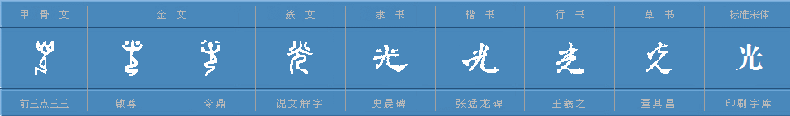
About Dr. Yaguang Zhang
Ya-
亚: second (best)
guang
光: light
↳ Family name, default setting
↳ Oracle bone script (~3000 years ago)
19
Notes:
If we dig more, we can find how that same character changes as time passes by. Originally, it was just a simple drawing…

Slide 20
About Dr. Yaguang Zhang
Ya-
亚: second (best)
guang
光: light
↳ Family name, default setting
↳ Oracle bone script (~3000 years ago)
20
Notes:
…depicting a person kneeling down on the ground while holding a long torch. We may need some imagination here, but this is the feet, this is the body, and this is the torch.
In my mind, this means this person is trying to serve others as best as he or she can, by providing light in this specific case, even if that requires kneeling down humbly.

Slide 21
About Dr. Yaguang Zhang
Ya-
亚: second (best)
guang
光: light
↳ Family name, default setting
Stride for excellence to humbly serve others
21
Notes:
In a word, when we put these two characters together, they could mean “stride for excellence to humbly serve others”.

Slide 22
About Dr. Yaguang Zhang
Ya-
亚: second (best)
guang
光: light
Far-fetched?
↳ Family name, default setting
Stride for excellence to humbly serve others
22
Notes:
Do you think this is a little far-fetched? After all, Chinese is an interesting language where the same character could be interpreted very differently.
I had the same doubts. So, I checked with my parents. And it turned out my name means something entirely different to them. Surprise, surprise.

Slide 23
About Dr. Yaguang Zhang
Ya-
亚: second (best)
guang
光: light
Far-fetched?
Still, I choose to interpret my name this way…
↳ Family name, default setting
Stride for excellence to humbly serve others
23
Notes:
But the point is, I still love this interpretation, and I have been trying my best to live my life following this.

Slide 24
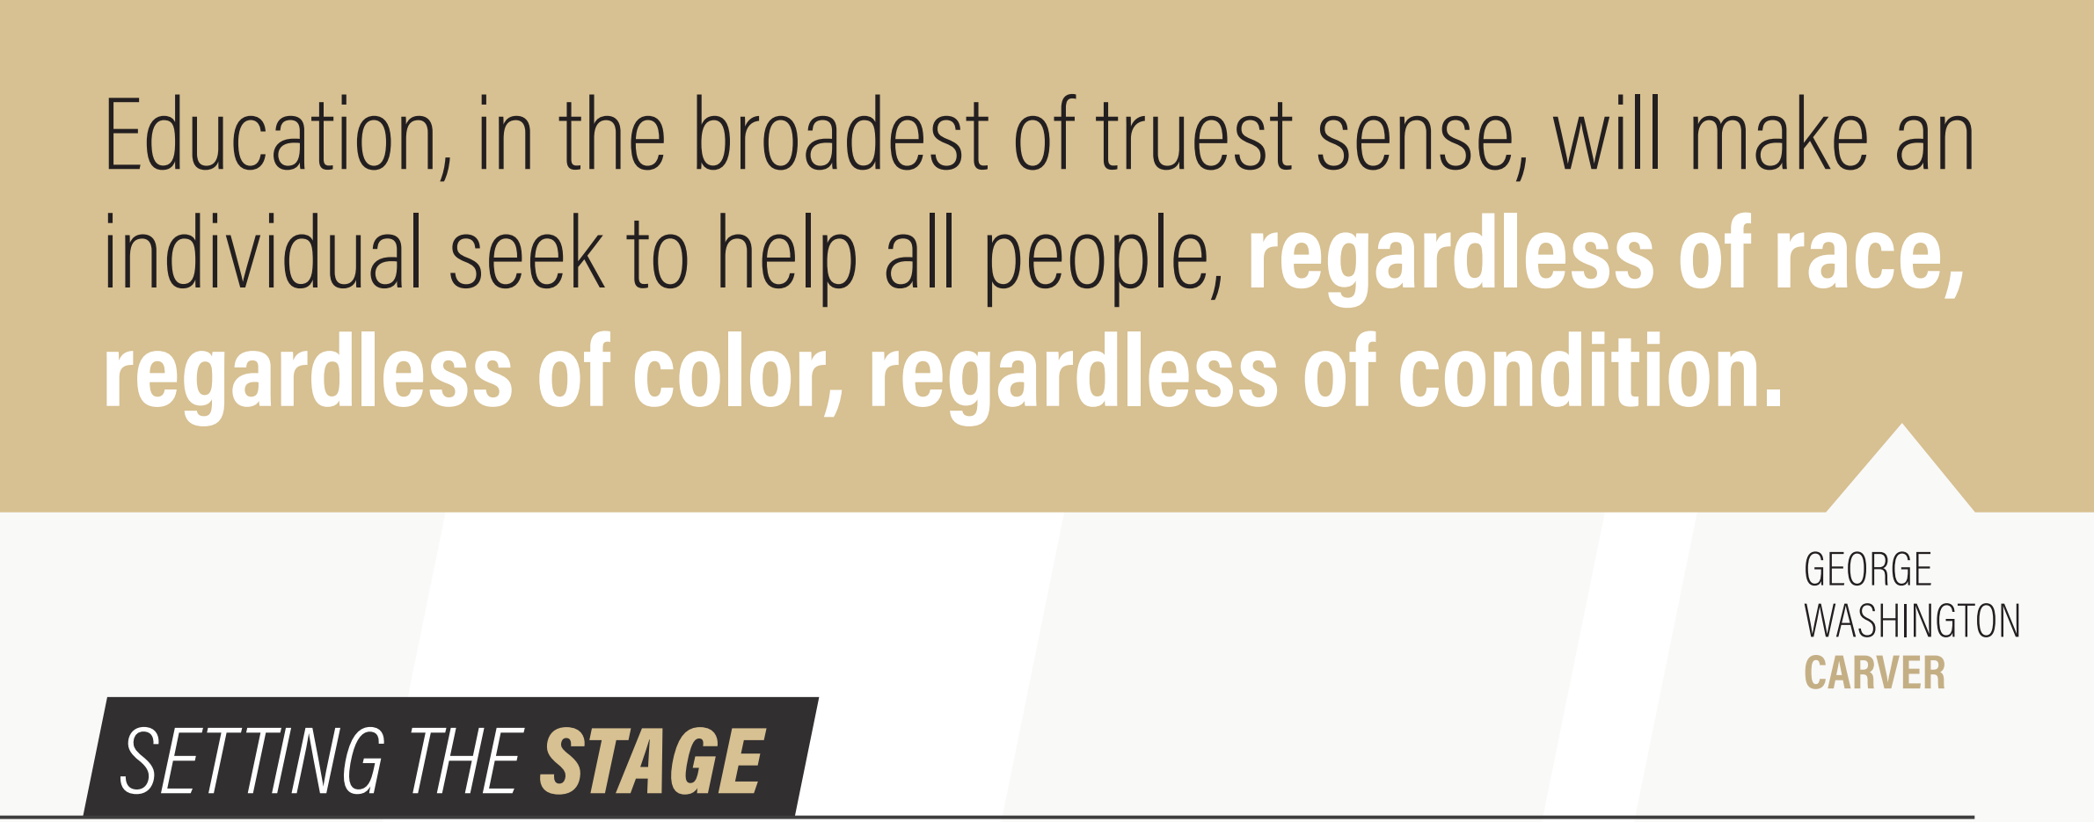
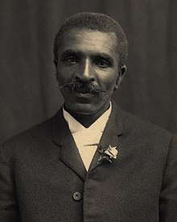
Pedagogical philosophy: Goals
What kind of students do we want to produce/cultivate?
24
2021-2026 College of Agriculture Strategic Plan
Notes:
That ties extremely well with the opening sentence of the 2021-2026 college of agriculture strategic plan: helping others is the key, regardless of race, color, and condition.

Slide 25
Pedagogical philosophy: Goals
What kind of students do we want to produce/cultivate?
Motivated to serve others
25
Notes:
I completely agree with this. Motivating students to serve others should be the ultimate goal. And it is a perfect answer for the question “What kind of students do we want to cultivate?”
My only complaint about this is, a high-level direction alone is not specific enough for us educators to apply this in our daily teaching. We need actionable, reproducible measures, to teach this vague life value.

Slide 26
Pedagogical philosophy: Approaches
Student Motivation
Exposure
Logic
Feeling
Reasoning
“It feels interesting!”
“I enjoy learning more about it.”
“It is useful!” “I need to learn it.”
26
Notes:
This is a good time for a high-level overview over actionable approaches to motivate students.
I normally classify student motivation into two types: feeling vs reasoning. When the students comment something like, “…” or ”…”, it is a good sign for the feeling type of motivation. Although not predictable at the individual level, this type of motivation is very powerful. What we can do on this side, is to expose the students to the topic of interest, preferably in a passionate and interesting manner.
On the other side we have reasoning. We could use logic to persuade the students that they would need something because it is useful, so useful that it will worth their time and effort to study hard. Let’s now have a look at a short teaching demo for the second approach: logic persuading.

Slide 27
Teaching demo: Optimization
A framework for guiding/making decisions
Data-driven
Can be used to set goals for AI
Good for AGR 333 - Data Science for Ag
27
Notes:
The topic I chose is mathematical optimization, which includes a set of very powerful tools to guide or make data-driven decisions. In fact, it is a very popular option for setting goals for AI. So… this demo fits well in the data science for agriculture course.

Slide 28
Teaching demo: Optimization
A framework for guiding/making decisions
Teaching goals:
Optimization is useful
Helping others is good
28
Notes:
In this particular demo, I will try to embed our educational goal, motivating students to help others, in the teaching.

Slide 29
Teaching demo: Optimization
A framework for guiding/making decisions
Cost function
Feasible region
Action
29
Notes:
First, let’s quickly go through some prerequisite knowledge here, because this demo works the best after the students already have a good intuition about how optimization works.
Roughly speaking, the optimization framework can be summarized with a “minimization problem”: we have the cost function f, which we want to minimize, by changing our action x. And possible actions are limited in a set called feasible region.
Intuitively, this formula means we want to find the minimum cost that is achievable with the actions we can take.

Slide 30
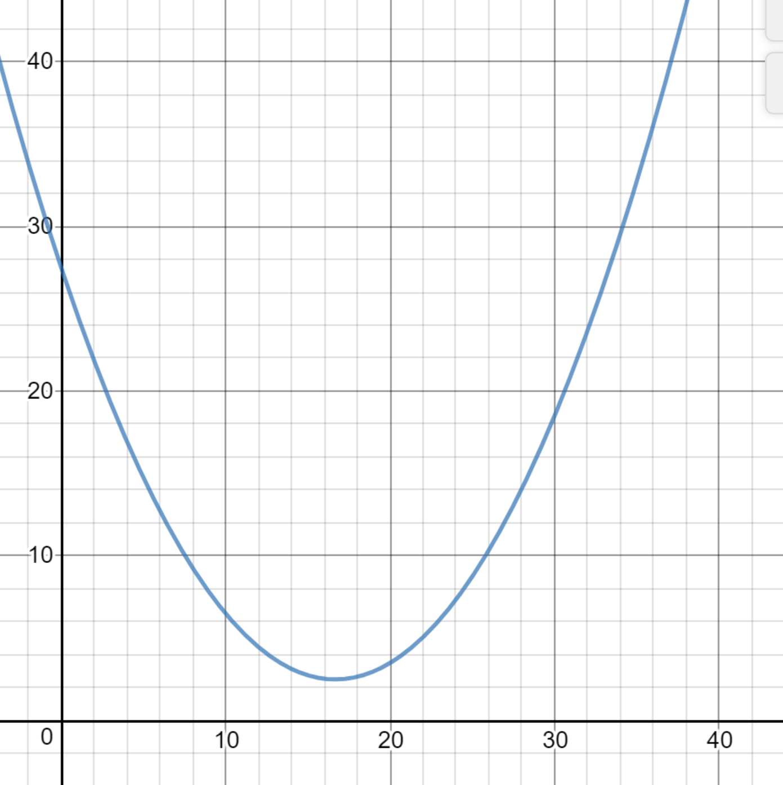
Teaching demo: Optimization
A framework for guiding/making decisions
Expense - yield
[0, 20]
Fertilizer amount
• (16.667, 2.5)
Example: How much nitrogen fertilizer should we apply?
30
Notes:
A simple application could be, how much nitrogen fertilizer should I apply in my field.
Here, we have the cost function being the expense on the fertilizer minus the yield of my field. This function is known in this example and represented by the curve on the plot. The minimization operation would then imply that we want to spend less money but get more yield.
The amount of fertilizer we can apply is limited between 0 and 20 units.
Note in this problem, the operation “min” is changed to “arg min”, because we need the best action that we can take, instead of the minimum value of the cost function.
It is clear that, we just need to find the lowest point on the curve, which in this case is (16.667, 2.5). Then the optimization problem is solved. We should apply this much of fertilizer, so that the cost function is minimized at 2.5.

Slide 31
Teaching demo: Optimization
A framework for guiding/making decisions
Expense - yield
[0, 10]
• (10, 6.5)
Fertilizer amount
• (16.667, 2.5)
Example: How much nitrogen fertilizer should we apply?
31
Notes:
Note that the feasible region controls what action is possible. If we shrink the region from 0 to 20 to 0 to 10, then the result will be a little worse than what we got before.

Slide 32
Teaching demo: Optimization
A framework for guiding/making decisions
Wider feasible region => More possibilities
Expense - yield
[0, 10]
• (10, 6.5)
Fertilizer amount
• (16.667, 2.5)
Example: How much nitrogen fertilizer should we apply?
32
Notes:
This makes sense, because if we allow a wider range of actions, it will be more likely for us to find better solutions.
I know this is a lot of information. I wish we had more time. Do we have any questions?

Slide 33
Teaching demo: Optimization
A framework for guiding/making decisions
Does “helping others” lead to a “better world”?
33
Notes:
That covers all the intuitions we need, so now we are ready for the real challenge: does helping others lead to a better world?

Slide 34
Teaching demo: Optimization
A framework for guiding/making decisions
ΣResource – Σ“happiness”
A high-
dimensional region
A vector (x₁, x₂, …)
Does “helping others” lead to a “better world”?
34
Notes:
For example, we could define the cost function as the total resource used by all of us minus the total happiness we get. Then, a better world would refer to “less resource consumption but more happiness”.
The action x will be a vector, with each element being the action one person takes. Correspondingly, the feasible region will be a high-dimensional region.

Slide 35
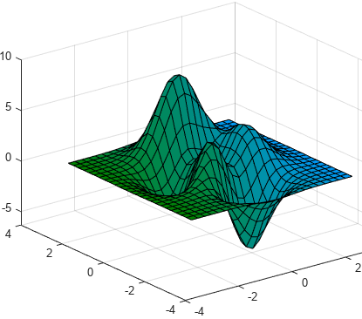
Teaching demo: Optimization
A framework for guiding/making decisions
ΣResource – Σ“happiness”
A high-
dimensional region
A vector (x₁, x₂, …)
Does “helping others” lead to a “better world”?
35
Notes:
As an illustration, this plot shows a 2-dimensional feasible region.

Slide 36
Teaching demo: Optimization
A framework for guiding/making decisions
ΣResource – Σ“happiness”
A high-
dimensional region
A vector (x₁, x₂, …)
Does “helping others” lead to a “better world”?
36
Notes:
The key for this discussion is that, by considering helping others, we are expanding the feasible region. Consider me going through a door. If I want to help others, I will spend some effort in observing whether there is anyone following me, and if so, I will hold the door for them. On the contrary, if I am completely selfish, meaning all my actions have to directly benefit myself, holding the door for others will not be in my feasible region. I will not take that action even into consideration.
In short, considering “helping others” gives us more action options.

Slide 37
Teaching demo: Optimization
A framework for guiding/making decisions
ΣResource – Σ“happiness”
A high-
dimensional region
A vector (x₁, x₂, …)
Does “helping others” lead to a “better world”?
37
Notes:
The best part is that, even one person’s choice matters. If we manage to educate one selfish student…

Slide 38
Teaching demo: Optimization
A framework for guiding/making decisions
ΣResource – Σ“happiness”
A high-
dimensional region
A vector (x₁, x₂, …)
Does “helping others” lead to a “better world”?
38
Notes:
to become happy helping others, we are essentially expanding the feasible region along that student’s axis.

Slide 39
Teaching demo: Optimization
A framework for guiding/making decisions
ΣResource – Σ“happiness”
Wider feasible region => More possibilities
A high-
dimensional region
A vector (x₁, x₂, …)
Does “helping others” lead to a “better world”?
39
Notes:
We know that a wider feasible region means more possibilities, so it will be more likely for us to reach a better optimization point, corresponding to a better world in this demo.

Slide 40
Teaching demo: Optimization
A framework for guiding/making decisions
Implications
Wider feasible region => Better solution
Equality
Wider feasible region => More possibilities
Does “helping others” lead to a “better world”?
40
Notes:
We can also deduce other implications. For example, this demo actually promotes equality, because to guarantee a solution not worse than before, we want to expand the feasible region without removing the grey “selfish” region, so that if the optimum point indeed falls in the selfish region, we can still accept that solution. This implies: “helping others” does not mean “pleasing others at all cost”; after all, we don’t have to always hold the door for others. It is better to treat any other person the same as we treat ourselves.

Slide 41
Teaching demo: Optimization
A framework for guiding/making decisions
Implications
Wider feasible region => Better solution
Equality
Example limitations
Quantification
Communication
Computation
Wider feasible region => More possibilities
Does “helping others” lead to a “better world”?
41
Notes:
There are also disadvantages with this approach. First of all, it is very challenging to quantify metrics such as amount of resource used, and happiness. On top of that, communicating these metrics properly so that the optimizer can get all the information needed, will incur a huge amount of overhead. Last but not least, even if all of these are taken care of, solving the optimization problem in a high-dimensional space will require a tremendous amount of computational power.
That being said, we are looking for better ways to quantify feelings, we are enabling cheaper, more efficient communication, and we are creating computers that are more powerful. So, if you are an optimist as I am, it makes sense to move toward helping others for the new possibilities of a “better world”.
Any questions?
------
Other interesting points:
- In a society with altruistic members, a selfish person can easily take advantage of the situation, e.g., by exaggerating their own needs.
- The altruism of one person can only be judged according to the action of that person.
- A person with selfish motivation to behave altruistically may suddenly abuse their power and hurt others’.
- Altruists may still change their mind.
- A person with action records of always being altruist, could be considered an altruist even if the motivation is selfish.

Slide 42
Pedagogical philosophy: Approaches
Student Motivation
Exposure
Logic
Feeling
Reasoning
“It feels interesting!”
“I enjoy learning more about it.”
“It is useful!” “I need to learn it.”
42
Notes:
I hope that is a good demonstration for how useful logic persuasion can be, to motivate our students.

Slide 43
Pedagogical philosophy: Approaches
More examples for Purdue Ag students
- Be proud: feeding the human being
- Be honored: best program in the US/world
Student Motivation
Exposure
Logic
Feeling
Reasoning
“It feels interesting!”
“I enjoy learning more about it.”
“It is useful!” “I need to learn it.”
43
Notes:
Just two quick examples for Purdue ag students. We can try to persuade them to be proud about their major, because they will serve the high purpose of feeding the human being, and to be honored as a member of Purdue Ag department, because they are enjoying the best Ag program in the US, and probably around the whole world.

Slide 44
Pedagogical philosophy: Approaches
Student Motivation
Exposure
Logic
Feeling
Reasoning
“It feels interesting!”
“I enjoy learning more about it.”
“It is useful!” “I need to learn it.”
44
Notes:
In fact, both approaches here, logic and exposure, are helpful beyond the purpose of motivation.

Slide 45
Pedagogical philosophy: Goals
What kind of students do we want to produce/cultivate?
Motivated to serve others
Able to self-learn/apply new skills (Meta skills)
Domain-specific knowledge and skills
45
Notes:
More specifically, they are critical in training students with domain-specific knowledge and skills, which our current education system is really good at, …

Slide 46
Pedagogical philosophy: Goals
What kind of students do we want to produce/cultivate?
Motivated to serve others
Able to self-learn/apply new skills (Meta skills)
Domain-specific knowledge and skills
46
Notes:
… as well as in equipping students with meta skills, the skills for learning new skills, including the ability to fetch relevant information via tools like Google and ChatGPT, and the ability to stay focused over relatively long time periods.
This goal about meta skills is getting more and more attention now… to some degree, because ChatGPT emerges as a huge success of AI development, and that poses an existential challenge to us educators.
Note that, the three goals here are ordered in priority based on my best judgement. That is, teaching a student to be a good person is more important than equipping them with meta skills, and meta skills are more important than domain-specific knowledge.

Slide 47
Pedagogical philosophy: Goals
Reality today?
Focus: Domain-specific knowledge and skills
Byproduct: Meta skills
Slogan: Motivated to serve others
47
Notes:
However, in practice, the priority order is reversed. We are very good at teaching specific knowledge and skills, so that becomes our focus.
The students may pick up meta skills as a byproduct, but we seldom intentionally or explicitly teach these skills.
And high-level purposes such as helping others often only stay as slogans. Hopefully, the teaching demo we just saw has proven that, there are actions we can take to improve this situation.

Slide 48
Pedagogical philosophy: Goals
Reality today?
Focus: Domain-specific knowledge and skills
Byproduct: Meta skills
Slogan: Motivated to serve others
The world is changing fast
Easier access to specific knowledge/skills.
48
Notes:
Anyway, is it OK to keep things as they are? Well, the reality calls for something different, because it will be easier and easier to get high-quality materials for specific knowledge and skills.

Slide 49
Pedagogical philosophy: Goals
Reality today?
Focus: Domain-specific knowledge and skills
Byproduct: Meta skills
Slogan: Motivated to serve others
The world is changing fast
Easier access to specific knowledge/skills.
Implications
Students with meta skills => more competitive
Instructions focusing on 1 may be replaced
49
Notes:
That has two implications. First, if our students graduate with only domain-specific knowledge and skills, their competitiveness will be very limited. The world is changing fast; future students simply need meta skills to adapt to that fact.
The second implication is that, if we human educators can only present facts as they are, we may be easily replaced.

Slide 50
Pedagogical philosophy: Goals
What kind of students do we want to produce/cultivate?
Motivated to serve others
Able to self-learn/apply new skills (Meta skills)
Domain-specific knowledge and skills
Human beings are the ultimate judge on life values.
50
Notes:
In my list, motivation goes first. AI so far does not have the ability to set goals for human society, and even if AI was able to, it would still be hard to guarantee or prove the goals set by AI actually align with what we human beings need. Long story short, we human beings are the ultimate judge on life values. So as human educators, it is our responsibility to make sure our students will become good people.

Slide 51
Pedagogical philosophy: Goals
What kind of students do we want to produce/cultivate?
Motivated to serve others
Able to self-learn/apply new skills (Meta skills)
Domain-specific knowledge and skills
Human beings are the ultimate judge on life values.
The world is changing fast.
51
Notes:
Also, it will be better if we prioritize meta skills over domain-specific knowledge and skills, given the fast-changing world.

Slide 52
Pedagogical philosophy: Goals
What kind of students do we want to produce/cultivate?
Motivated to serve others
Able to self-learn/apply new skills (Meta skills)
Domain-specific knowledge and skills
Human beings are the ultimate judge on life values.
The world is changing fast.
Creators and developers
(vs users) of technology
52
Notes:
That does not mean domain-specific knowledge and skills will become obsolete. They are for sure important, especially if we want our students to become creators and developers of new technology (instead of merely users), just we probably do not want to kill possibilities on our students’ side by focusing only on this.

Slide 53
More about me
“The best that can be expected of an average student in the modern education system.”
Motivated to serve others
Meta skills
Domain-specific knowledge and skills
53
Notes:
A little more about me. Again, this is me going out of my comfort zone for the sake of this talk. If you know me in person, you will notice that I am a humble, young lad who hates to talk about his achievements.
With an honest evaluation, I think I can represent “the best that can be expected …”
First of all, I am always happy to serve others.

Slide 54
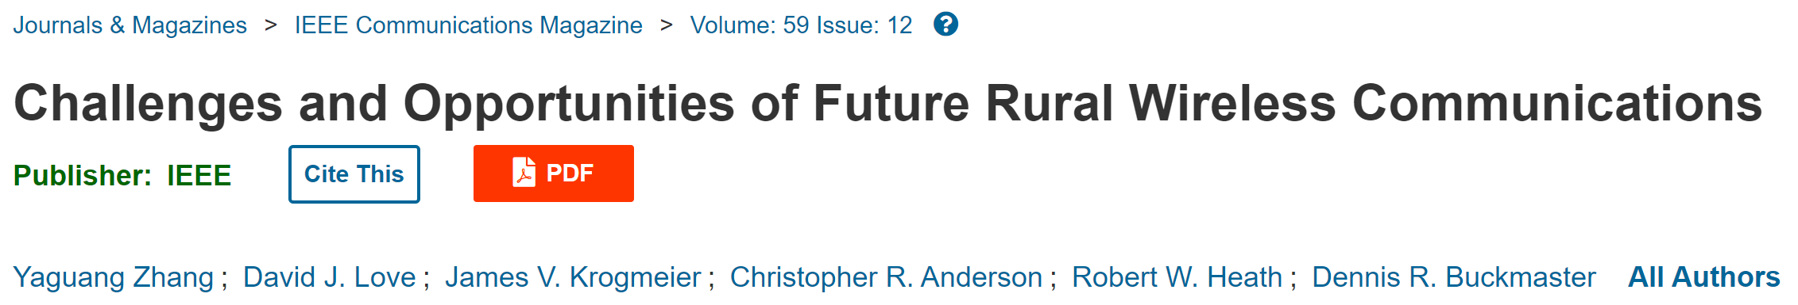
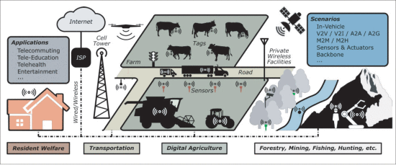
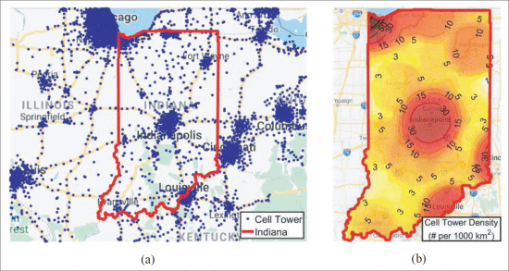
More about me
“The best that can be expected of an average student in the modern education system.”
Motivated to serve others
Meta skills
Domain-specific knowledge and skills
54
Notes:
And I am especially motivated to help improve equality. One direction of my research is to help bridge the digital gap between urban and rural areas.

Slide 55
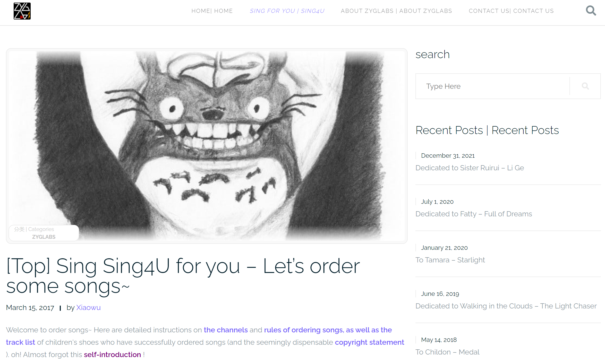
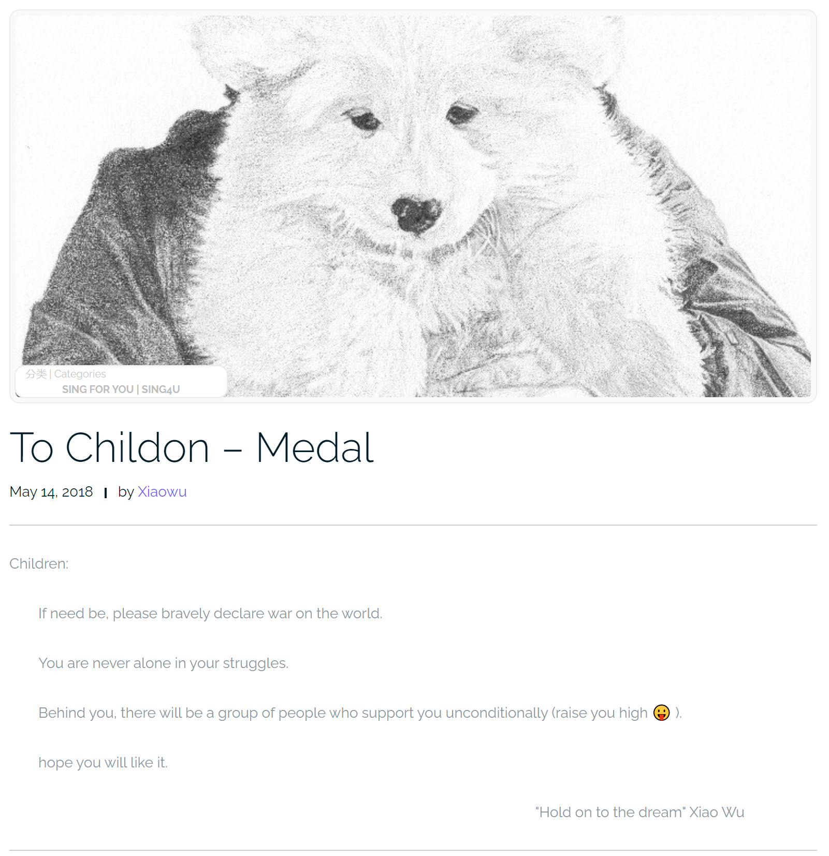

More about me
“The best that can be expected of an average student in the modern education system.”
Motivated to serve others
Meta skills
Domain-specific knowledge and skills
55
Notes:
During my free time, I give free drawings and song covers to people online who request that, just to cheer them up.

Slide 56
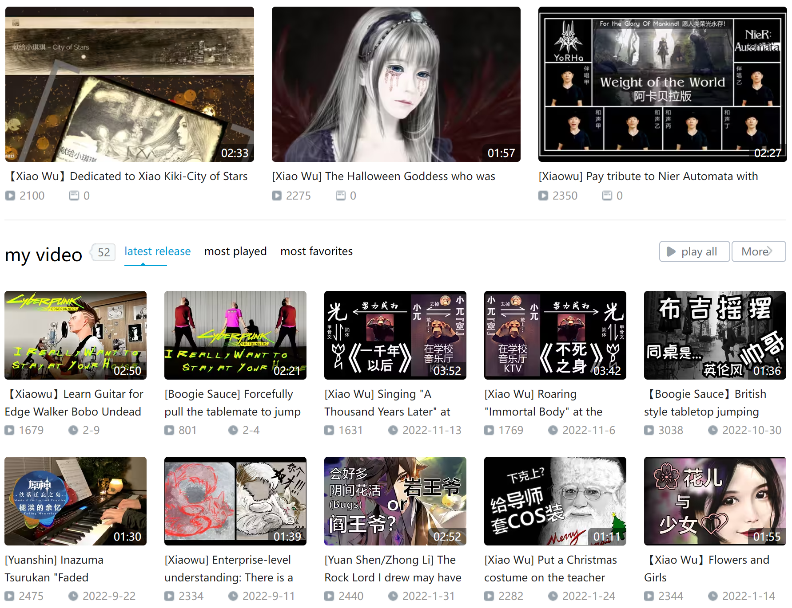
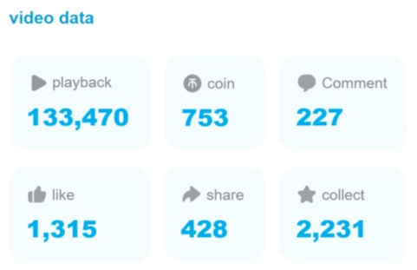
More about me
“The best that can be expected of an average student in the modern education system.”
Motivated to serve others
Meta skills
Domain-specific knowledge and skills
56
Notes:
I am also a hobbyist content creator. So I know a lot about audio and video editing.

Slide 57
More about me
“The best that can be expected of an average student in the modern education system.”
Motivated to serve others
Meta skills
Domain-specific knowledge and skills
- Drawing
- Painting
- Guitar
- Piano
- Singing
- Video editing
- Audio editing
- Web development
57
Notes:
Along the way, I self-learned a series of skills. And I sincerely believe I can become anyone I want, simply because I know how to train myself. It will be great if my students can develop the same confidence provided by meta skills.
------
…so that they can explore and enjoy this wonderful world.

Slide 58
More about me
“The best that can be expected of an average student in the modern education system.”
Motivated to serve others
Meta skills
Domain-specific knowledge and skills
What has made me who I am today?
How to duplicate the good characteristics?
58
Notes:
So, I have been keeping asking myself, what has made me who I am today? How do I duplicate the good parts of me in my students?

Slide 59
More about me
“The best that can be expected of an average student in the modern education system.”
Motivated to serve others
Meta skills
Domain-specific knowledge and skills
What has made me who I am today?
Fully trusting the instructors
Not brilliant, but hard-working
How to duplicate the good characteristics?
59
Notes:
For the first question. The answer contains two parts. One, I fully trust the instructors, so even though I am not on the brilliant side, I always try my best to meticulously follow the instructions.
I still remember there was one math professor of mine, who said to the class: if you do not understand something I teach, just memorize it. So… that was what I did. The strategy helped, but the memorizing part was simply painful.

Slide 60
More about me
“The best that can be expected of an average student in the modern education system.”
Motivated to serve others
Meta skills
Domain-specific knowledge and skills
What has made me who I am today?
Fully trusting the instructors
Not brilliant, but hard-working
How to duplicate the good characteristics?
60
Earn the trust
Notes:
You cannot expect that level of trust from all the students. So, I know when I become an instructor, I need to earn the trust, by teaching things the students feel interesting and useful, and by making it personal, showing them that I care,

Slide 61
More about me
“The best that can be expected of an average student in the modern education system.”
Motivated to serve others
Meta skills
Domain-specific knowledge and skills
What has made me who I am today?
Fully trusting the instructors
Not brilliant, but hard-working
Exposed to challenges and opportunities
How to duplicate the good characteristics?
61
Earn the trust
Encourage students to explore
Notes:
I have also been extremely lucky to have a wide range of experiences. Some of them provided the defining moments of my life. So I want to encourage my students to experience more, if they have the chance.

Slide 62
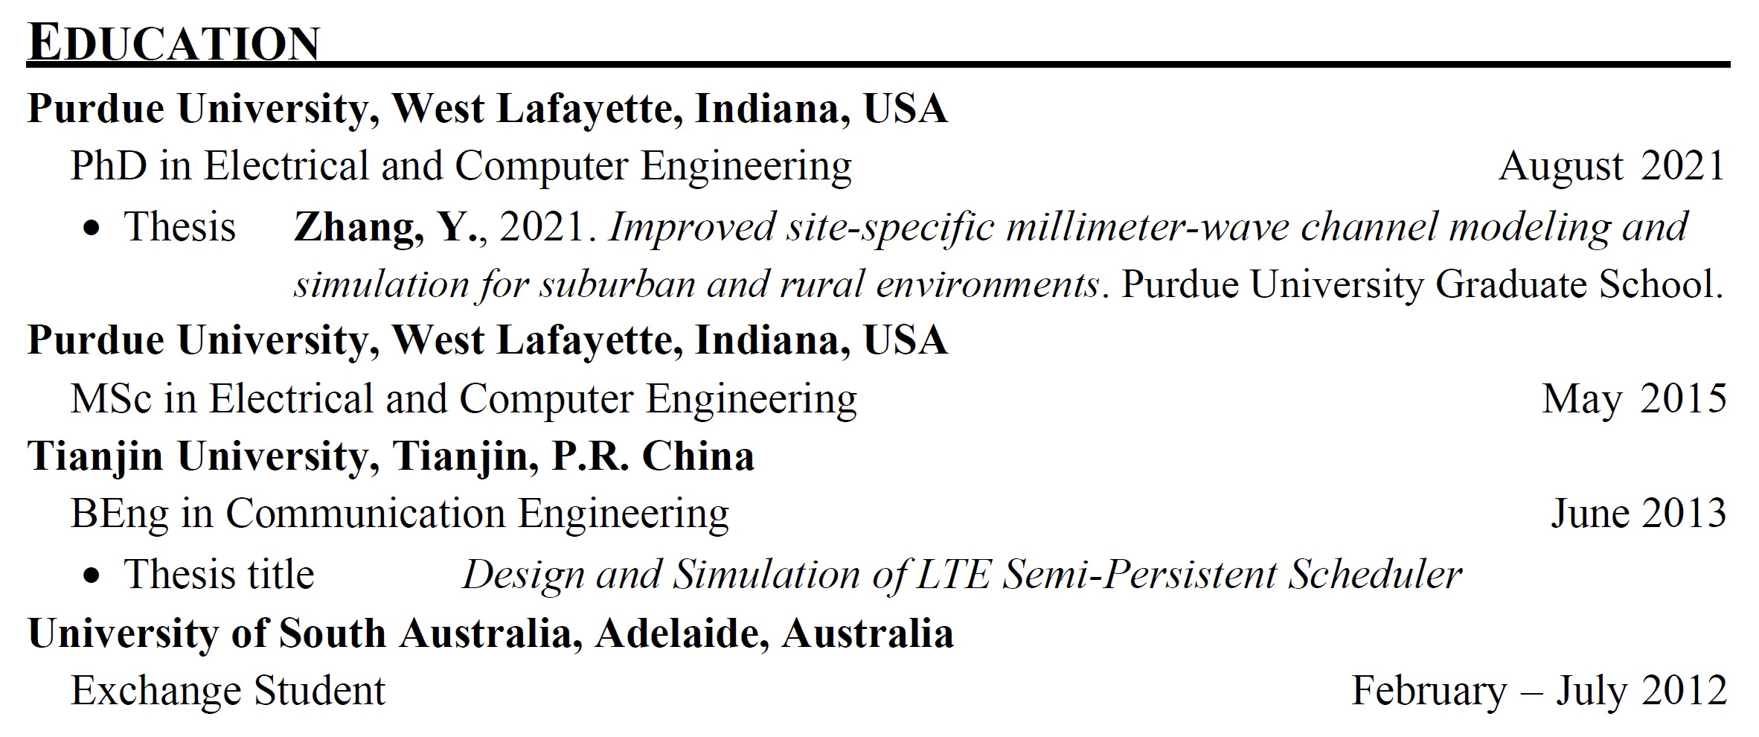
More about me
“The best that can be expected of an average student in the modern education system.”
Motivated to serve others
Meta skills
Domain-specific knowledge and skills
Western - US
Asian
62
Western - Australia
Notes:
For example, I was privileged with the opportunity to experience three quite different education systems. At the US, as we all know, you will get enough freedom and resources to grow as high as you can reach. The Asian culture can really humble you. The Australian education system feels like a service business to me, highly professional and highly efficient.
When a student is exposed to this large portion of the world, their stereotypes about people will be challenged again, again, and again, to the point where it is probably easier to just treat everyone independently. Also, they are more likely to have friends of different backgrounds, and it is hard to discriminate strangers who appear similar to your friends.

Slide 63
Pedagogical philosophy: Approaches
Student Motivation
Exposure
Logic
Feeling
Reasoning
“It feels interesting!”
“I enjoy learning more about it.”
“It is useful!” “I need to learn it.”
63
Notes:
That is why I believe exposure can help motivate a student to become a better person.
------
Other exposures include:
Role model
Mentoring
Services to community

Slide 64
Why online education?
64
Notes:
Now, I’d like to share with you one piece of my experience, as a volunteer teacher in a remote village. That experience was so eye-opening, and even mind-blowing. It basically shaped my attitude toward online education.
At that time, I was a junior undergraduate student. A summer service program was recruiting volunteer teachers, so I just participated without much thinking. We were dropped off out of the village because it was in a mountainous area. The only way to enter the village was by foot. And because of the poor transportation, local economy was extremely undeveloped. There was no tap water. Only one building had electricity.
We took care of about 30 kids. Interestingly, they were from different grades. Later, we learned that the whole elementary school only had two teachers, so all the kids, no matter how old they were, almost always attended the same class. These conditions were challenging, but still acceptable to me.
Then there was this one little girl in the class, about 7 or 8 years old, holding her baby brother, who was maybe only 1 or 2 years old. The girl was so tiny herself, that her baby brother’s head appeared unproportionally big. And it seemed the baby was just hanging down in front of her, because she was too tiny to to hold the baby horizontally as people normally do. That scene was so unusual to me that it will be stuck in my head for the rest of my life.
I still don’t know how to handle a baby, but she was so good. The baby was behaving himself, so she must have had done that very often. It turned out that, their parents went out of the village to make money, so they were left with their grandparents in the village. We found later the whole village basically only had elderly people and kids in it.

Slide 65
Why online education?
A supplement (a cheaper alternative)
A practical remedy for undeveloped areas
65
Notes:
With that, let’s come back to the question. Why online education? To many, online education is an alternative, cheaper option to traditional on-campus education.
To me, online education is the only practical remedy for the kids I met. They simply had too little resource to support anything else.

Slide 66
Pedagogical philosophy: Emerging challenges
66
Notes:
Of course, that was about 15 years ago. The living condition in that village probably has been improved dramatically.
Still, if I imagine I were one of the kids there, and maybe during one visit of my parents back to the village, I got a phone as present. In that case, would I use the phone to take online courses?

Slide 67
Pedagogical philosophy: Emerging challenges
Who are we (as online educators) competing with?
67
Notes:
I really wish the answer is yes, but the fact is, I am a very disciplined person and I have taken many online courses myself. The majority of them only cover pieces of specific knowledge. Because of that, I frequently feel board, sometimes even fall asleep taking these course.

Slide 68
Pedagogical philosophy: Emerging challenges
Who are we (as online educators) competing with?
Online entertainment
Deliberately designed by experts to be addictive
68
Notes:
To an average kid, TikTok and games will be way more attractive than online course. After all, they were deliberately designed to be addictive, often with the help of hundreds, if not thousands, of experts.

Slide 69
Pedagogical philosophy: Emerging challenges
Who are we (as online educators) competing with?
Online entertainment
What are we competing for?
Next generation’s attention
Deliberately designed by experts to be addictive
A limited resource for keeping ideas
69
Notes:
However, to actually benefit the students, we really need their intense attention over a long time. Fighting for their attention is a big deal, because whatever get the attention of the next generation, will secure its position to be preserved in future human civilization.

Slide 70
Pedagogical philosophy: Emerging challenges
Who are we (as online educators) competing with?
Online entertainment
What are we competing for?
Next generation’s attention
Deliberately designed by experts to be addictive
A limited resource for keeping ideas
Useful ideas vs fun ideas
70
Notes:
We educators want a bigger slice of this “limited resource“ to keep ideas that we believe are useful, while online entertainment wants a bigger slice to keep ideas they are fun.
It is hard to argue which side is right, but it is crystal clear that we online educators won’t win the competition if we do not change.

Slide 71
Rethinking “best practices” in online education
The world is changing fast
Common practices today are probably not best practices in the future
71
Notes:
In fact, changing will be the norm for online education if we want to keep up with the fast-changing world.

Slide 72
Rethinking “best practices” in online education
The world is changing fast
Common practices today are probably not best practices in the future
Proposal, implementation, evaluation, and promotion of “better practices”
72
Notes:
In that sense, we may not want to be too obsessed with the “best practices”; instead, we need establish procedures to streamline the proposal, implementation, evaluation, and promotion of “better practices”.

Slide 73
Rethinking “best practices” in online education
The world is changing fast
Common practices today are probably not best practices in the future
Proposal, implementation, evaluation, and promotion of “better practices”
Candidates for better practices?
Most successful training tool: games
Most useful education content: real-life skills
73
Notes:
But first thing first, what can we propose as the candidates for better practices? Well, search no further, one of the competitors we just identified, video games, have been extremely successful in training people with complicated knowledge and amazing skills. Unfortunately, because they are highly entertainment-focused, the majority of the content they teach do not directly apply in real life. Is there a way to combine that with what we want to teach? So that the students can be addictive to learning and applying real-life skills?

Slide 74
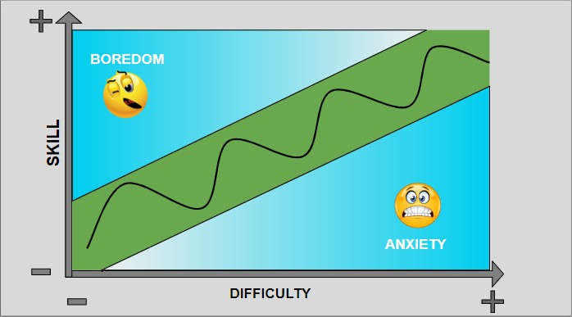
Game design
The “flow” state
https://thinkgamedesign.com/flow-theory-game-design/
74
Notes:
Let’s first step back a little bit and look at what modern “game design” can achieve. One of the key ideas is the “flow” state, as represented by the green region in this plot. We have difficulty as the x axis, and the skill level of the player as the y axis. On the one hand, if the game is too easy for the player, the player will feel bored. On the other hand, if the game is too difficult, the player will feel anxious. So we want to keep the player in the green area.
However, this is easier said than done, because the process is dynamic. As time goes by, the play will get better and better at the game. How does a game adapt to that?
What’s more, there are more than one player. Each of them will start at a different skill level and will learn at different speeds. How can a game adapt to that?

Slide 75
Selected game design techniques
Flow (as a rough guideline)
Progress control
Challenges
Intuitive visual hints
Frequent positive feedback
Points/virtual currency
Achievements
Real-time preformation evaluation
The power of habits
Daily/weekly/monthly missions
75
Notes:
The video game industry is very mature today. They have a large set of tricks or techniques to help achieve the “flow” state.
For example, intuitive visual hints, … by points, virtual currency, and achievements. Real-…, so that you can learn almost immediately whether an action is good or not after you take it. And the power… they will train you to play the games regularly with the rewards.

Slide 76
Selected game design techniques
Flow (as a rough guideline)
Progress control
Challenges
Intuitive visual hints
Frequent positive feedback
Points/virtual currency
Achievements
Real-time preformation evaluation
The power of habits
Daily/weekly/monthly missions
Huge amount of content
Beta tests
User survey
High-quality arts (both visual and audio)
Trailers/ads
Localization (e.g., multi-language)
Multi-platform
Community
Real-life events/rewards
Gotcha mechanism (gambling)
…
76
Notes:
The competition there in the game industry is extremely intense. The result is, there are actually way more techniques than highlighted here, many of them do not even follow any design principle. They just work to make the games more attractive.

Slide 77
Selected game design techniques
Flow (as a rough guideline)
Progress control
Challenges
Intuitive visual hints
Frequent positive feedback
Points/virtual currency
Achievements
Real-time preformation evaluation
The power of habits
Daily/weekly/monthly missions
Huge amount of content
Beta tests
User survey
High-quality arts (both visual and audio)
Trailers/ads
Localization (e.g., multi-language)
Multi-platform
Community
Real-life events/rewards
Gotcha mechanism (gambling)
…
“Let’s be do whatever we can to make games fun!”
77
Notes:
I really like this extremely pragmatic attitude. Their goal is to make games fun. For that, they will do whatever they can.

Slide 78
Let’s be do whatever we can to help students learn more easily?
Selected game design techniques
Flow (as a rough guideline)
Progress control
Challenges
Intuitive visual hints
Frequent positive feedback
Points/virtual currency
Achievements
Real-time preformation evaluation
The power of habits
Daily/weekly/monthly missions
Huge amount of content
Beta tests
User survey
High-quality arts (both visual and audio)
Trailers/ads
Localization (e.g., multi-language)
Multi-platform
Community
Real-life events/rewards
Gotcha mechanism (gambling)
…
“Let’s be do whatever we can to make games fun!”
78
Notes:
Should we educators do whatever we can to help students learn real-life skills more easily?

Slide 79
Let’s be do whatever we can to help students learn more easily?
Selected game design techniques
Flow (as a rough guideline)
Progress control
Challenges
Intuitive visual hints
Frequent positive feedback
Points/virtual currency
Achievements
Real-time preformation evaluation
The power of habits
Daily/weekly/monthly missions
Huge amount of content
Beta tests
User survey
High-quality arts (both visual and audio)
Trailers/ads
Localization (e.g., multi-language)
Multi-platform
Community
Real-life events/rewards
Gotcha mechanism (gambling)
…
“Let’s be do whatever we can to make games fun!”
79
Notes:
Anyway, in this huge list, I want to first discuss the “intuitive visual hints”, which has been used intensively in this presentation.

Slide 80
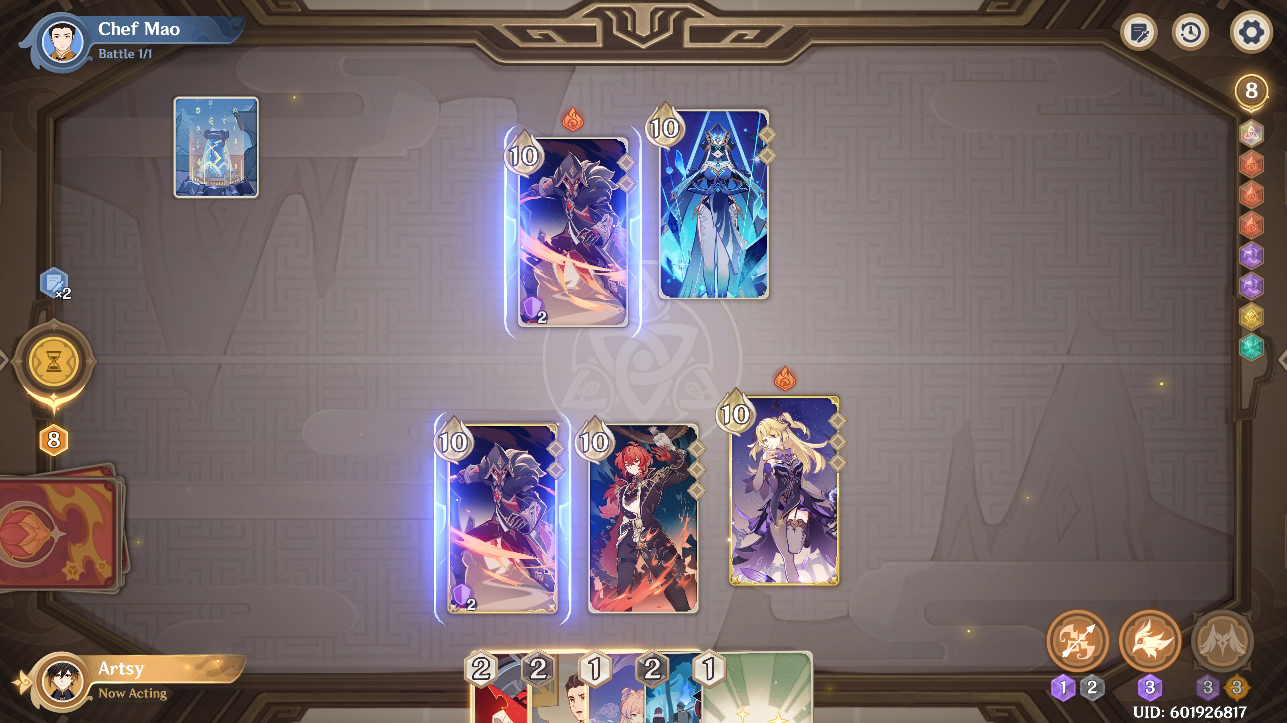
Selected game design techniques
80
Notes:
This is a screenshot from a very popular mobile game called Genshin Impact, which literally means the “impacts of original gods”.

Slide 81

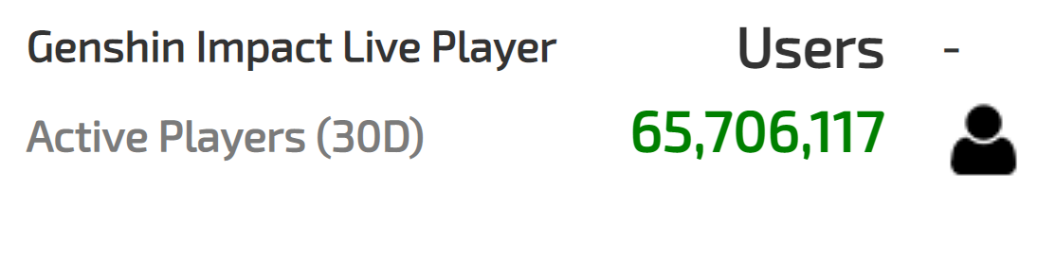
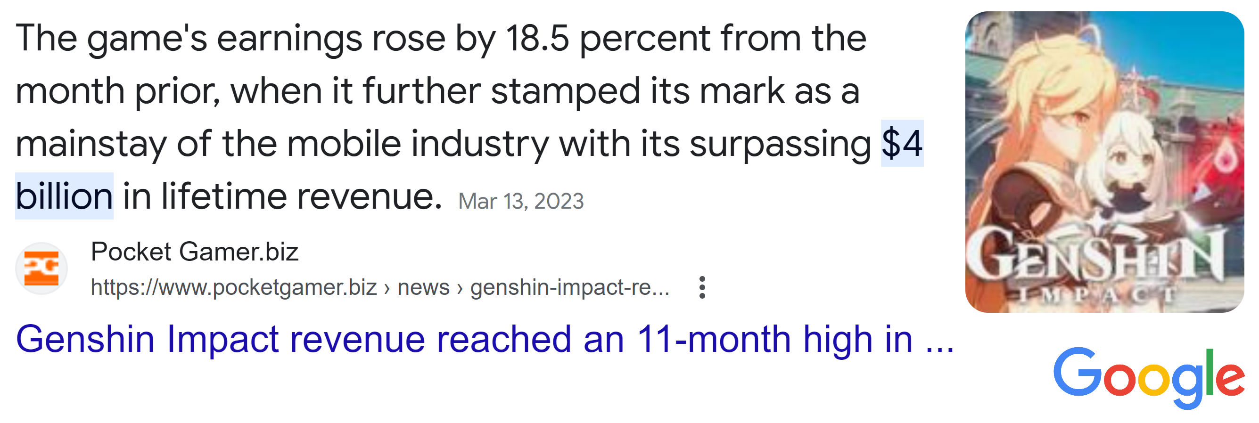
Selected game design techniques
As of 5/4/2023 https://activeplayer.io/genshin-impact/
81
Notes:
It is one of the recent “miracles” in the game industry, because this game targets global players who are as young as 12 years old. And its ambition actually made a huge success: they have millions of active players and 4 billion dollars of revenue in 2 years.

Slide 82
Selected game design techniques
82
Notes:
Their huge design team has made sure that the visual hints in the game are as intuitive as possible.

Slide 83
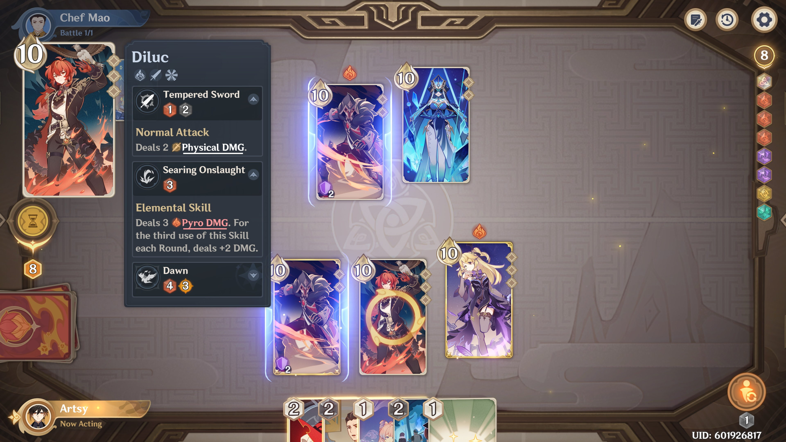
Selected game design techniques
83
Notes:
For example, if you don’t understand something, you can always try clicking on it to reveal hints. Key ideas are highlighted.

Slide 84
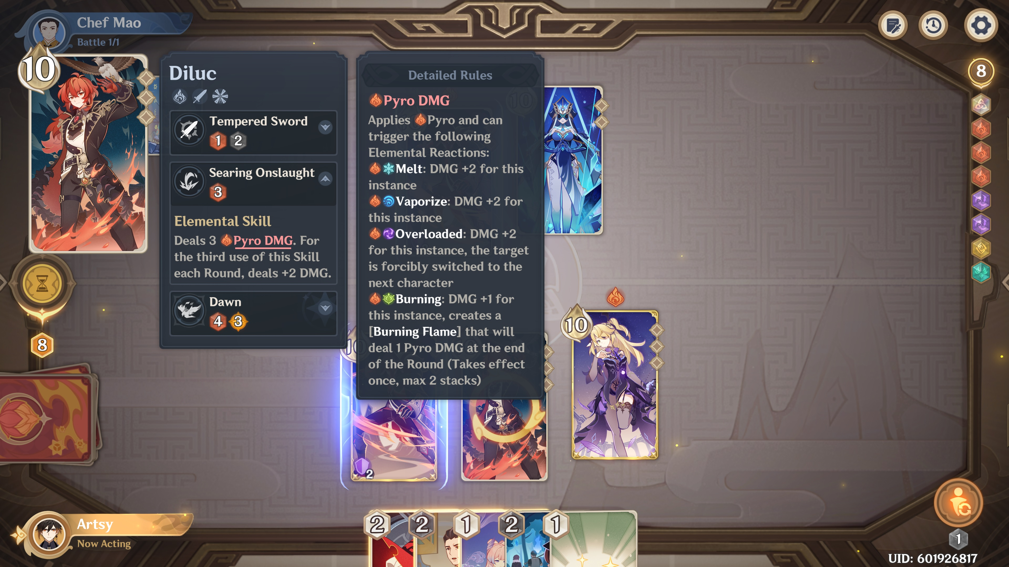
Selected game design techniques
84
Notes:
You can click on them to get more explanations. As we can see, the rules are quite complicated, yet the game managed to teach millions of users to mater the details.
These are only the real-time hints you can get when you are in a game.

Slide 85
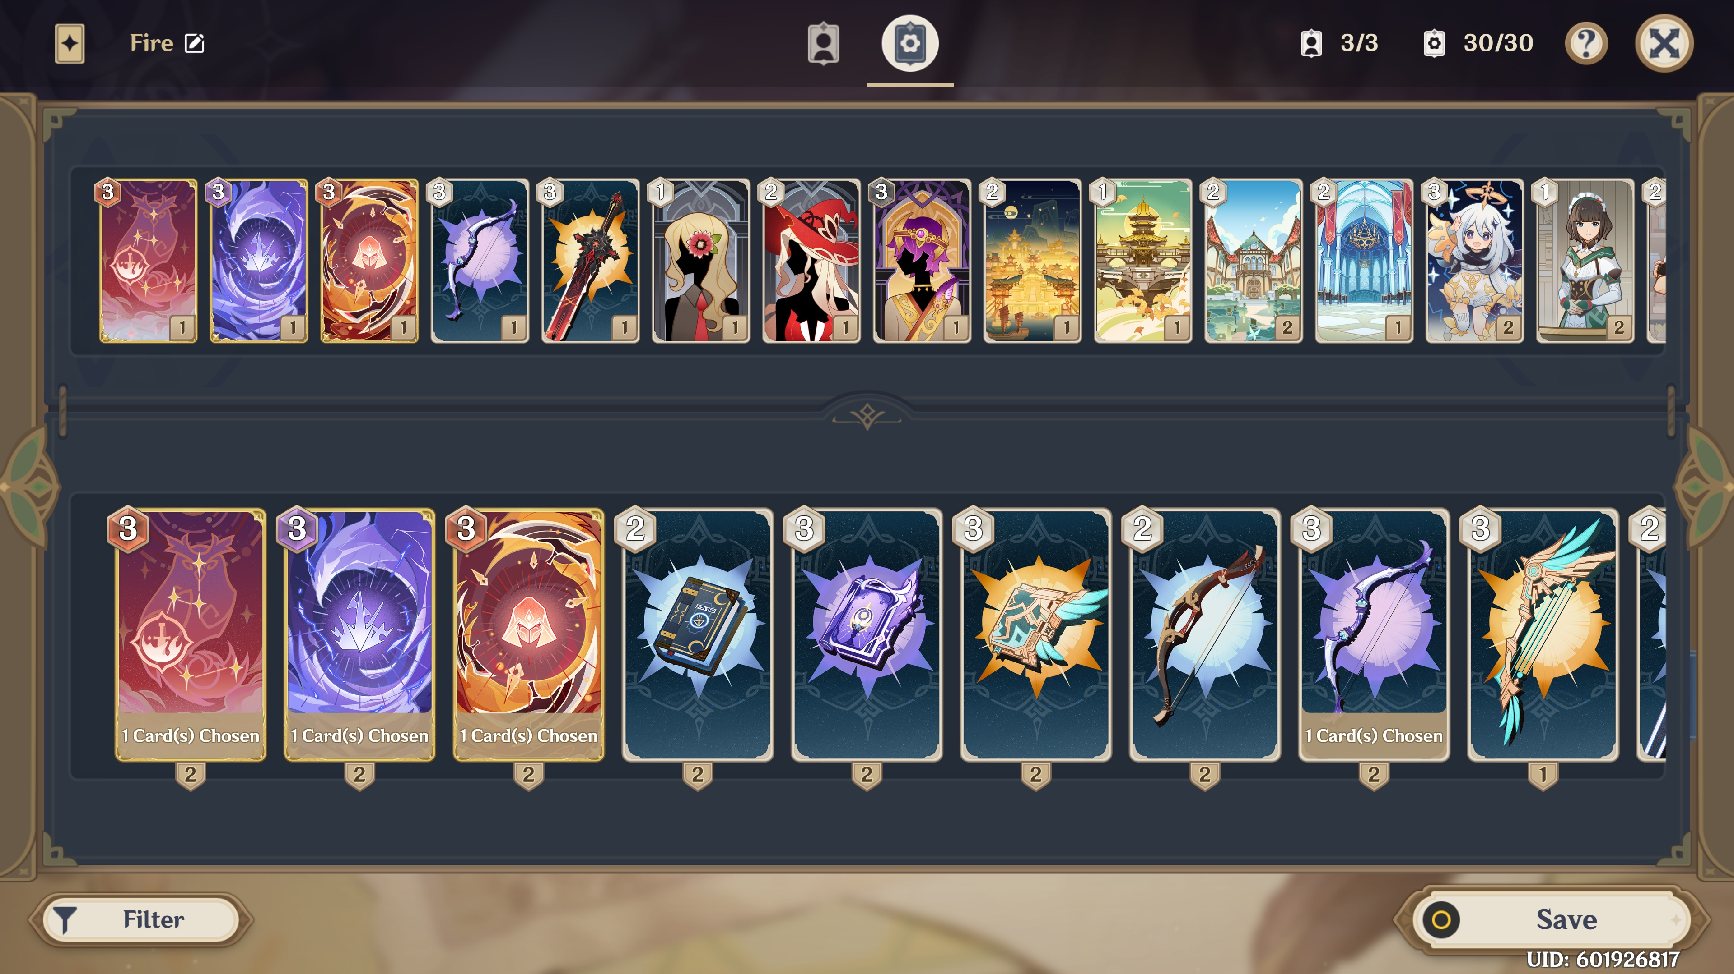
Selected game design techniques
85
Notes:
They also have a built-in portal for players to learn more on their own if needed.

Slide 86

Selected game design techniques
86
Notes:
What is more, they have comprehensive Wikipedia pages, where even the most advanced players can learn something new.
And all these materials are interactive with extremely intuitive visual hints.
By the way, this example clearly shows that: games accept the reality that learning requires repetition. They never assume that the players can master something with one round of learning.

Slide 87
Selected game design techniques
Flow (as a rough guideline)
Progress control
Challenges
Intuitive visual hints
Make the learning experience effortless
Reduce effort/cost in fetching study materials
87
Notes:
In summary, these hints make the learning experience effortless, especially because the interactive features dramatically reduce the effort required to fetch new study materials.

Slide 88
Selected game design techniques
Flow (as a rough guideline)
Progress control
Challenges
Intuitive visual hints
Make the learning experience effortless
Reduce effort/cost in fetching study materials
Huge amount of content for all levels with progress control and rewards
“Let’s be do whatever we can to make games fun!”
88
Notes:
From this example, we can see how much content is available if the player wants to learn more.
This is actually another overarching game design principle we can directly follow in online education.
We have to provide more materials than a typical student can digest, so that we will not limit how fast students can learn, or how high the students can reach. On the contrary, we want to provide rewards, either virtual or material, to encourage students to progress faster.
But the caveat is, this framework can easily overwhelm many students, so we need mechanisms to test whether the students are ready for more content, and if not, we need to intentionally limit their progress.
------
It also goes with the idea of achieving the “flow” state.

Slide 89
Let’s be do whatever we can to help students learn more easily?
Selected game design techniques
Flow (as a rough guideline)
Progress control
Challenges
Intuitive visual hints
Frequent positive feedback
Points/virtual currency
Achievements
Real-time preformation evaluation
The power of habits
Daily/weekly/monthly missions
Huge amount of content
Beta tests
User survey
High-quality arts (both visual and audio)
Trailers/ads
Localization (e.g., multi-language)
Multi-platform
Community
Real-life events/rewards
Gotcha mechanism (gambling)
…
“Let’s be do whatever we can to make games fun!”
89
Notes:
Now, I really want to go through all the techniques here, because a lot of them can be very inspiring, but we do not have enough time. The least I can say is, all of these techniques are widely adopted and they actually work in real life.

Slide 90
Tailoring game design techniques for AGR 333 - Data Science for Agriculture
Rough guidelines
The “flow” state
Huge amount of content for all levels with progress control and rewards
90
Notes:
Next, let’s move on to example actionable items for the data science for agriculture course.
------
I do want to discuss two techniques more carefully, because they are good candidates for better practice in online education.

Slide 91
Tailoring game design techniques for AGR 333 - Data Science for Agriculture
Rough guidelines
The “flow” state
Huge amount of content for all levels with progress control and rewards
Actionable items
Expanding content
91
Notes:
Following the guidelines we saw, the first thing I would like to do for this course, is to expand the available content.

Slide 92
Tailoring game design techniques for AGR 333 - Data Science for Agriculture
Rough guidelines
The “flow” state
Huge amount of content for all levels with progress control and rewards
Actionable items
Expanding content
Data-driven decision-making:
Optimization
92
Notes:
We have seen one demo for optimization, which will be good to teach data-driven decision-making.

Slide 93
Tailoring game design techniques for AGR 333 - Data Science for Agriculture
Rough guidelines
The “flow” state
Huge amount of content for all levels with progress control and rewards
Actionable items
Expanding content
Data collection & processing:
Digital signal processing
Data-driven decision-making:
Optimization
93
Notes:
Now, let’s go back to the live demo of the guitar performance, and talk about digital signal processing.

Slide 94
Live demo for digital signal processing
Extremely good example for intuition
Sensors => Microphone
Data => Sampled & quantized air pressure
Processing => In time & frequency
Easy access + “tangible”
94
Notes:
This demo will be a very good low-level introduction to data science, to help students build rough ideas about where the data comes from, how to prepare the data for easier storage and processing, and what are the basic operations on data streams.
The biggest advantage is that, the equipment is easy to get, and the results are tangible. For example, (in time domain, we can see … listen … clip and move …) (in frequency domain, we can … frequency components … filter).
That is what I mean by “tangible”. We can hear the data ourselves, which will make it easier for the students to develop intuitions. And all operations are simple enough for the students to duplicate, for example, in Python, as coding exercises.

Slide 95
Live demo for digital signal processing
Extremely good example for intuition
Sensors => Microphone
Data => Sampled & quantized air pressure
Processing => In time & frequency
Easy access + “tangible” + interesting
Teach the skill first + cover the topics
95
Notes:
Note that this demo is not directly related to ag. I chose it anyway because I believe future education will focus on skills, instead of domain-specific knowledge. So, we may not want to limit what to teach in introductory sessions.
If we are teaching probability, gambling problems are good intro materials regardless of which major we are teaching. Similarly, audio processing has so many advantages that I feel it deserves to be covered even in an ag course.
That being said. We do want to provide a lot of agriculture examples.

Slide 96
Tailoring game design techniques for AGR 333 - Data Science for Agriculture
Rough guidelines
The “flow” state
Huge amount of content for all levels with progress control and rewards
Actionable items
Expanding content
Skill tree
96
Notes:
That is where the skill tree can help.

Slide 97
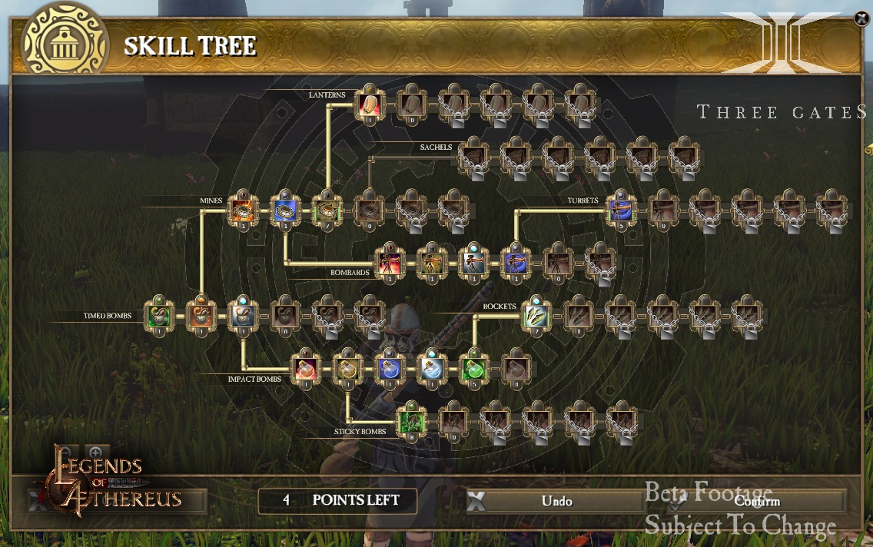
Tailoring game design techniques for AGR 333 - Data Science for Agriculture
Skill tree – Non-linear structure
97
Notes:
A skill tree, essentially, is a non-linear approach for organizing materials with dependency. It can provide a high-level overview of what prerequisites are needed, and what future possibilities are, for each skill of interest.
In games, the tree is typically visually pleasing and interactive. So you can click on any skill that you are interested in to get more materials.

Slide 98
Tailoring game design techniques for AGR 333 - Data Science for Agriculture
Skill tree – Non-linear structure
Why do we need a “non-linear” structure?
Traditional teaching: topics covered once are assumed to be mastered by the students.
Fact: repetition is required for learning.
98
Notes:
Why do we need a non-linear structure for online materials? Well, this is determined by the fact that each online student can adjust their progress based on their needs.
In traditional classroom settings, that is not practical. Instructors can not simply go back to a previous covered topic because a few students feel they want to know more about it. Instructors have to prioritize the needs of the majority.
However, the online learning experience can be tailored for each student, in the sense that they should have the freedom to explore new materials freely, or go back to review old topics as needed. Hints on the dependency of the materials can make that easier on the students’ side.

Slide 99
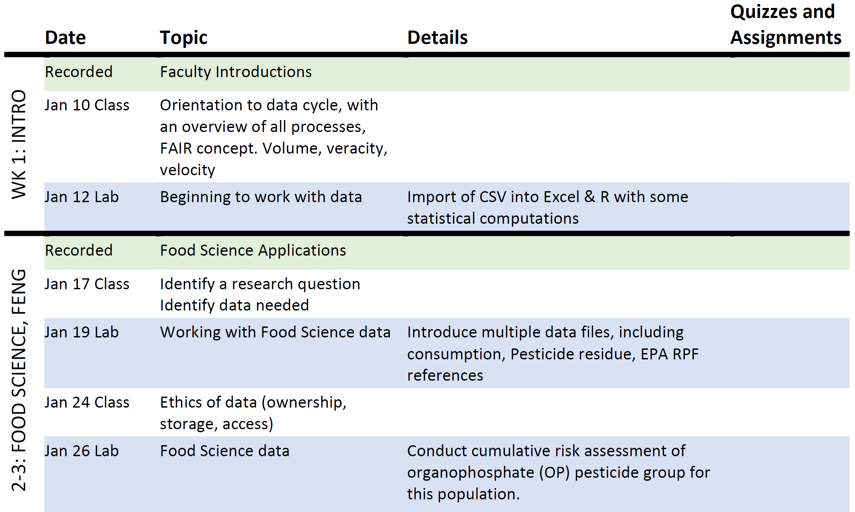
Tailoring game design techniques for AGR 333 - Data Science for Agriculture
Skill tree – Non-linear structure
Add a new column Skill
99
Notes:
This idea fit education very well. The first thing I would encourage professors to do in the data science for agriculture course, is to identify the skills they want to teach, and create a skill tree accordingly.
Again, skills are what we should teach and focus on in the future. Topics are materials we use to teach the skills. Skills are the “core” of the course. Topics are the “flavor” of the course.

Slide 100
Tailoring game design techniques for AGR 333 - Data Science for Agriculture
Skill tree – Non-linear structure
Signal generation
(digital sensors)
Time domain
Frequency domain
Big data
1D signal
Quantization
Pitch
Microphone
Sampling
Temperature sensor
Data type
Filtering
Moisture sensor
2D signal
Machine learning
Camera
3D signal
GPS receivers
Large-volume datasets
Parallel computing
LiDAR
100
Nationwide LiDAR
Notes:
For example, if we add digital signal processing into the course, we could start with a skill tree like this one for it.

Slide 101
Tailoring game design techniques for AGR 333 - Data Science for Agriculture
Skill tree – Non-linear structure
Signal generation
(digital sensors)
Time domain
Frequency domain
Big data
1D signal
Quantization
Pitch
Microphone
Sampling
Temperature sensor
Data type
Filtering
Moisture sensor
2D signal
Machine learning
Camera
3D signal
GPS receivers
Large-volume datasets
Parallel computing
LiDAR
101
Nationwide LiDAR
Notes:
We will teach signal generation, techniques in time and frequency domains, and tools for big data.

Slide 102
Tailoring game design techniques for AGR 333 - Data Science for Agriculture
Skill tree – Non-linear structure
Signal generation
(digital sensors)
Time domain
Frequency domain
Big data
1D signal
Quantization
Pitch
Microphone
Sampling
Temperature sensor
Data type
Filtering
Moisture sensor
2D signal
Machine learning
Camera
3D signal
GPS receivers
Large-volume datasets
Parallel computing
LiDAR
102
Nationwide LiDAR
Notes:
Audio processing is the introductory topic for the basic ideas.

Slide 103
Tailoring game design techniques for AGR 333 - Data Science for Agriculture
Skill tree – Non-linear structure
Signal generation
(digital sensors)
Time domain
Frequency domain
Big data
1D signal
Quantization
Pitch
Microphone
Sampling
Temperature sensor
Data type
Filtering
Moisture sensor
2D signal
Machine learning
Camera
3D signal
GPS receivers
Large-volume datasets
Parallel computing
LiDAR
103
Nationwide LiDAR
Notes:
Ag-related topics are covered after that, to repeatedly expose students to the same skill sets.

Slide 104
Tailoring game design techniques for AGR 333 - Data Science for Agriculture
Skill tree – Non-linear structure
Signal generation
(digital sensors)
Time domain
Frequency domain
Big data
1D signal
Quantization
Pitch
Microphone
Sampling
Temperature sensor
Data type
Filtering
Moisture sensor
2D signal
Machine learning
Camera
3D signal
GPS receivers
Large-volume datasets
Parallel computing
LiDAR
104
Nationwide LiDAR
Notes:
Selected state-of-the-art topics are introduced to widen the students’ view.

Slide 105
Tailoring game design techniques for AGR 333 - Data Science for Agriculture
Skill tree – Non-linear structure
Signal generation
(digital sensors)
Time domain
Frequency domain
Big data
1D signal
Quantization
Pitch
Microphone
Sampling
Temperature sensor
Data type
Filtering
Moisture sensor
2D signal
Machine learning
Camera
3D signal
GPS receivers
Large-volume datasets
Parallel computing
LiDAR
105
Nationwide LiDAR
Notes:
This way, progress control can be easily done based on the dependency of materials. Here, new materials will be unlocked only after the students finish all prerequisites and pass the corresponding tests.

Slide 106
Tailoring game design techniques for AGR 333 - Data Science for Agriculture
Rough guidelines
The “flow” state
Huge amount of content for all levels with progress control and rewards
Actionable items
Expanding content
Skill tree
Point system
106
Notes:
This approach is also compatible with the point system for frequent positive rewards.

Slide 107
Tailoring game design techniques for AGR 333 - Data Science for Agriculture
Point system – Positive feedback to encourage progress
Signal generation
(digital sensors)
Time domain
Frequency domain
Big data
100
100
1D signal
Quantization
Pitch
100
100
Microphone
Sampling
Temperature sensor
100
100
Data type
Filtering
100
Moisture sensor
2D signal
Machine learning
100
Camera
3D signal
GPS receivers
Large-volume datasets
Parallel computing
LiDAR
107
Nationwide LiDAR
My points: 500
Notes:
The point system is very powerful due to its flexibility. We can assign points to each module to encourage progress.

Slide 108
Tailoring game design techniques for AGR 333 - Data Science for Agriculture
Point system – Positive feedback to encourage progress
Signal generation
(digital sensors)
Time domain
Frequency domain
Big data
100
100
1D signal
Quantization
Pitch
100
100
Microphone
Sampling
Temperature sensor
100
100
Set bonus: 100
Data type
Filtering
100
Moisture sensor
2D signal
Machine learning
100
Camera
3D signal
GPS receivers
Large-volume datasets
Parallel computing
LiDAR
108
Nationwide LiDAR
My points: 500
Notes:
We can grant extra points for finishing a group of modules.

Slide 109
Tailoring game design techniques for AGR 333 - Data Science for Agriculture
Point system – Positive feedback to encourage progress
Signal generation
(digital sensors)
Time domain
Frequency domain
Big data
100
100
1D signal
Quantization
Pitch
100
100
Microphone
Sampling
Temperature sensor
100
100
Set bonus: 100
Data type
Filtering
100
Moisture sensor
2D signal
Machine learning
100
Camera
3D signal
50
Large-volume datasets
Parallel computing
GPS receivers
50
LiDAR
109
Nationwide LiDAR
My points: 500
Notes:
We can assign smaller amounts of points for less important or easier content.

Slide 110
Tailoring game design techniques for AGR 333 - Data Science for Agriculture
Point system – Positive feedback to encourage progress
Signal generation
(digital sensors)
Time domain
Frequency domain
Big data
100
100
1D signal
Quantization
Pitch
100
100
Microphone
Sampling
Temperature sensor
100
100
Set bonus: 100
Data type
Filtering
100
Moisture sensor
2D signal
200
Machine learning
100
Camera
3D signal
50
Large-volume datasets
200
GPS receivers
Parallel computing
50
LiDAR
110
150
Nationwide LiDAR
My points: 500
Notes:
We can assign bigger amounts of points for required or challenging content.

Slide 111
Tailoring game design techniques for AGR 333 - Data Science for Agriculture
Point system – Positive feedback to encourage progress
Signal generation
(digital sensors)
Time domain
Frequency domain
Big data
100
100
1D signal
Quantization
Pitch
100
100
Microphone
Sampling
Temperature sensor
100
100
Set bonus: 100
Data type
Filtering
100
Moisture sensor
2D signal
200
Machine learning
100
Camera
3D signal
Unlock this module group with 200 points
50
Large-volume datasets
200
GPS receivers
Parallel computing
50
LiDAR
150
Nationwide LiDAR
My points: 500
Notes:
We can also use the point system for implicit progress control. Here, students have to earn enough points first before getting access to a new group of materials.

Slide 112
Tailoring game design techniques for AGR 333 - Data Science for Agriculture
Point system – Positive feedback to encourage progress
Signal generation
(digital sensors)
Time domain
Frequency domain
Big data
100
100
1D signal
Quantization
Pitch
100
100
Microphone
Sampling
Temperature sensor
100
100
Set bonus: 100
Data type
Filtering
100
Moisture sensor
2D signal
200
Machine learning
100
Camera
3D signal
Unlock this module group with 200 points
50
Large-volume datasets
200
GPS receivers
Parallel computing
50
LiDAR
150
10
Nationwide LiDAR
Daily challenge
My points: 500
Notes:
We can release daily challenges to help students develop the habit of studying everyday.

Slide 113
Tailoring game design techniques for AGR 333 - Data Science for Agriculture
Point system – Positive feedback to encourage progress
Signal generation
(digital sensors)
Time domain
Frequency domain
Big data
100
100
1D signal
Quantization
Pitch
100
100
Microphone
Sampling
Temperature sensor
100
100
Set bonus: 100
Data type
Filtering
100
Moisture sensor
2D signal
200
Machine learning
100
Camera
Required to pass the course
3D signal
Unlock this module group with 200 points
50
Large-volume datasets
200
GPS receivers
Parallel computing
50
LiDAR
150
Nationwide LiDAR
My points: 500
Notes:
We can set some modules as “required” to pass the course, and other as “bonus” for students who want to learn more or earn more points.

Slide 114
Tailoring game design techniques for AGR 333 - Data Science for Agriculture
Point system – Positive feedback to encourage progress
Signal generation
(digital sensors)
Time domain
Frequency domain
Big data
100
100
1D signal
Quantization
Pitch
100
100
Microphone
Sampling
Temperature sensor
100
100
Required to pass the course
Set bonus: 100
Data type
Filtering
100
Moisture sensor
2D signal
200
Machine learning
100
Camera
3D signal
Unlock this module group with 200 points
50
Large-volume datasets
200
GPS receivers
Parallel computing
50
LiDAR
150
Nationwide LiDAR
My points: 500
Notes:
We can easily change the boundaries, to fit the course better to the requirements of different student groups.

Slide 115
Tailoring game design techniques for AGR 333 - Data Science for Agriculture
Point system – Positive feedback to encourage progress
Competition
Real-time ranking: most points earned
115
Notes:
What’s more, in this framework, we can take advantage of the students’ desire to compete and win, by using leaderboards.

Slide 116
Tailoring game design techniques for AGR 333 - Data Science for Agriculture
Point system – Positive feedback to encourage progress
Competition
Real-time ranking: most points earned
Real-life awards/gifts to winners
116
Notes:
We can promise real-life awards to the winners.

Slide 117
Tailoring game design techniques for AGR 333 - Data Science for Agriculture
Point system – Positive feedback to encourage progress
Competition
Real-time ranking: most points earned
Real-life awards/gifts to winners
Virtual currency
Homework hints
One-to-one real-time tutoring
117
Notes:
We can treat the points as virtual currency for the students to trade for more resources, such as hints and tutoring time.

Slide 118
Tailoring game design techniques for AGR 333 - Data Science for Agriculture
Point system – Positive feedback to encourage progress
Competition
Real-time ranking: most points earned
Real-life awards/gifts to winners
Virtual currency
Homework hints
One-to-one real-time tutoring
Hidden challenges
Research ideas
118
Notes:
We can add bonus materials for students who progress faster, and reward those who successfully complete the content.

Slide 119
Tailoring game design techniques for AGR 333 - Data Science for Agriculture
Point system – Positive feedback to encourage progress
Competition
Real-time ranking: most points earned
Real-life awards/gifts to winners
Virtual currency
Homework hints
One-to-one real-time tutoring
Hidden challenges and achievements
Research ideas and silly jokes
119
Notes:
We can frequently surprise the students with small hidden achievements to confirm their efforts, for example, if they get a task done, within a limited time or, without using hints.
I am particularly fond of this little idea. Because we instructors can come up with silly jokes for the achievements, which could be a lot of fun.

Slide 120
Tailoring game design techniques for AGR 333 - Data Science for Agriculture
Hidden/explicit achievements
🏃 Speedrunner! +10 points
Get a specific task done within a limited time.
“Either don’t run or… run like crazy!”
🧐 Mindreader! +10 points
Get a specific task done without using any hints.
“Hints are not necessary…’cause I’m good at
reading your mind!”
A modern game may have hundreds of small achievements for more frequent positive feedback.
120
Notes:
Imagine getting an achievement like these two as a student: Speedrunner … Mindreader …
These are very positive feedback to reward “being concentrated” and “working independently”.
As a reference, a modern game may have hundreds of small achievements for more frequent positive feedback.

Slide 121
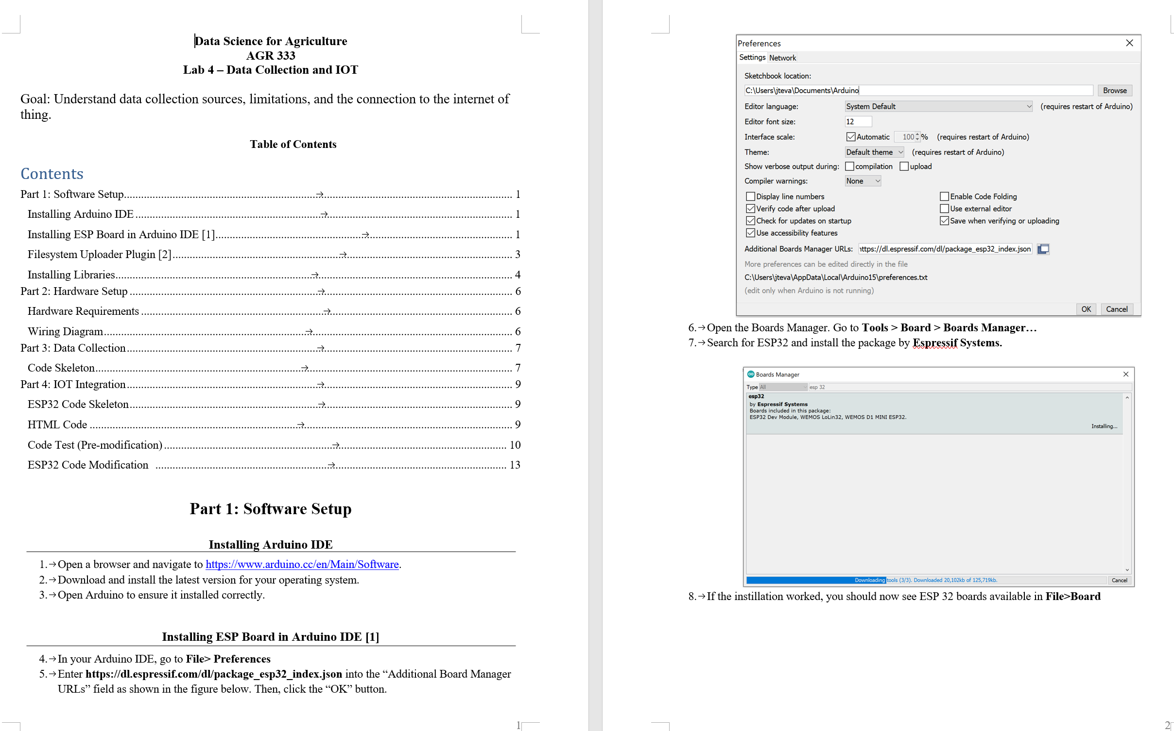
Tailoring game design techniques for AGR 333 - Data Science for Agriculture
Assignments – Hide hints by default
Notes:
Within this framework, one lab assignment could fit as a block or one link in the details of the block. Here is an example lab from the data science for ag course.

Slide 122
Tailoring game design techniques for AGR 333 - Data Science for Agriculture
Assignments – Hide hints by default
The ability to follow instructions +
The ability to find solutions and solve problems
Notes:
We all know about the high quality of Purdue’s teaching materials, but there are a few small tricks that we can apply here to prioritize the abilities of finding solutions and solving problems, over the ability to follow instructions.

Slide 123
Tailoring game design techniques for AGR 333 - Data Science for Agriculture
Assignments – Hide hints by default
Hints
Hints
The ability to follow instructions +
The ability to find solutions and solve problems
Hints
Notes:
For example, by default, we could hide all the step-by-step instructions, so that they serve as hints if the student gets stuck somewhere. The titles now will be the tasks for the students to solve on their own.

Slide 124
Tailoring game design techniques for AGR 333 - Data Science for Agriculture
Assignments – Hide hints by default
Hints
Hint: Google “Download Arduino IDE”
The ability to follow instructions +
The ability to find solutions and solve problems
Hints
Notes:
If necessary, we can give a simpler version of the hint for free.

Slide 125
Tailoring game design techniques for AGR 333 - Data Science for Agriculture
Assignments – Hide hints by default
My remaining points: 500
Illusional scarcity: by allowed # of hints
or the point system
Hints
Unlock with 10 points
Unlock with 3 points
Hints
The ability to follow instructions +
The ability to find solutions and solve problems
Unlock with 2 points
Hints
Notes:
We can further encourage students to work on these tasks independently, by creating an “illusional scarcity” feeling for the hints. Here, students can use the limited amount of points they have earned to unlock more hints.

Slide 126
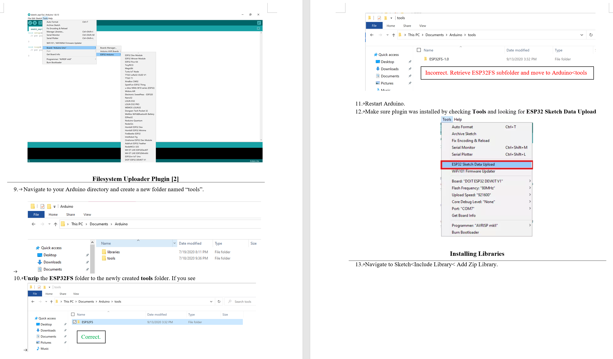
Tailoring game design techniques for AGR 333 - Data Science for Agriculture
Assignments – Automated performance evaluation
Checkpoint-1: Pass this check point to get 5 points.
Unlocked hints
Unlocked hints
Unlocked hints
Unlock with 1 points
Hints
(Partially) Automated check point
Notes:
Another key feature we need is automated performance evaluation. In this example, we want to make sure a plugin is correctly installed. If so, the student passes the test and gets some points.

Slide 127
Tailoring game design techniques for AGR 333 - Data Science for Agriculture
Assignments – Automated performance evaluation
Checkpoint-1: Pass this check point to get 5 points.
Unlocked hints
Unlocked hints
I confirm things are correct. [ ]
Or
Run this script and copy the output below (more instructions):
Unlocked hints
Unlock with 1 points
Hints
(Partially) Automated check point
Copy the output here
Submit
Notes:
We could ask the student to either (i) check manually and get the point by confirming things are right, or (ii) run a check script locally and upload the results. AI may play a key role here to provide real-time feedback along with the performance evaluation results.

Slide 128
Tailoring game design techniques for AGR 333 - Data Science for Agriculture
Rough guidelines
The “flow” state
Huge amount of content for all levels with progress control and rewards
Actionable items
Expanding content
Skill tree
Point system
128
Notes:
In summary, the skill tree is an extremely natural way of progress monitoring and control. The flexibility provided by it is just beyond imagination.
We can even apply it out of a course, for example, for other things like major selection, degree requirements, even for explaining key roles of the department or university.

Slide 129
Institute-level support
Procedures to streamline proposing, testing, promoting better practices
Student performance before and after taking different versions of the same the course
Individual rewards for confirmed better, mimicable practices
Expert support
Professors, game designers, visual artists, programmers, …
129
Notes:
At last, as we have mentioned before, it will be great if we have procedures at the institute level to support proposing, testing, promoting better practices in online teaching.
Essentially, nobody can guarantee new techniques will work, even those proposed here. We need a strict evaluation system to objectively score the effects.
For example, we could check the long-term performance of the students. A good course should be able to improve their performance out of that course.
We also need more incentives for pioneering educators.
And as much support as possible from other experts, if we are serious about competing with online entertainment.

Slide 130


Thank you!
Dr. Yaguang Zhang ygzhang@purdue.edu
Notes:
To me, this is the perfect time to start this conversation, because the past five years witnesses tremendous changes in education. Online education became popular about one decade ago. Then the pandemic really push it to the center of main stage, with more tools and companies appearing to support it. Last year, the sudden success of ChatGPT shows the urgency of improving online education to its next level.
I am very excited about this, because I can literally feel we are standing at the boarder or limit of the online education. In front of us, is the vast uncharted land for us to explore. But at the same time, I am a little scared, too, again because of the unknown. It almost feels like I will head into the darkness. That is why I chose the song, Hey Jude, as the live performance early today. To encourage myself, and anyone who are interested, to start the journy.
That is all I’d like to cover today. I hope you have enjoyed the seminar. Thank you very much.
---
The past five years witnessed… Pandemic. Online by force. ChatGPT.
What we can learn from other players in the entertainment industry, for example, freelancer content creators.
That is all we would like to cover today.
It seems we still have a few minutes left. Do we have more questions?

Slide 131
Tailored game design techniques in this talk
Motivation:
Tell stories/Be personal
Take advantage of interesting topics
Rewards
Training approach:
Repeated exposures to key ideas
Incremental in small steps
Visual hints
131
Notes:
Be different. Show the passion.

Slide 132
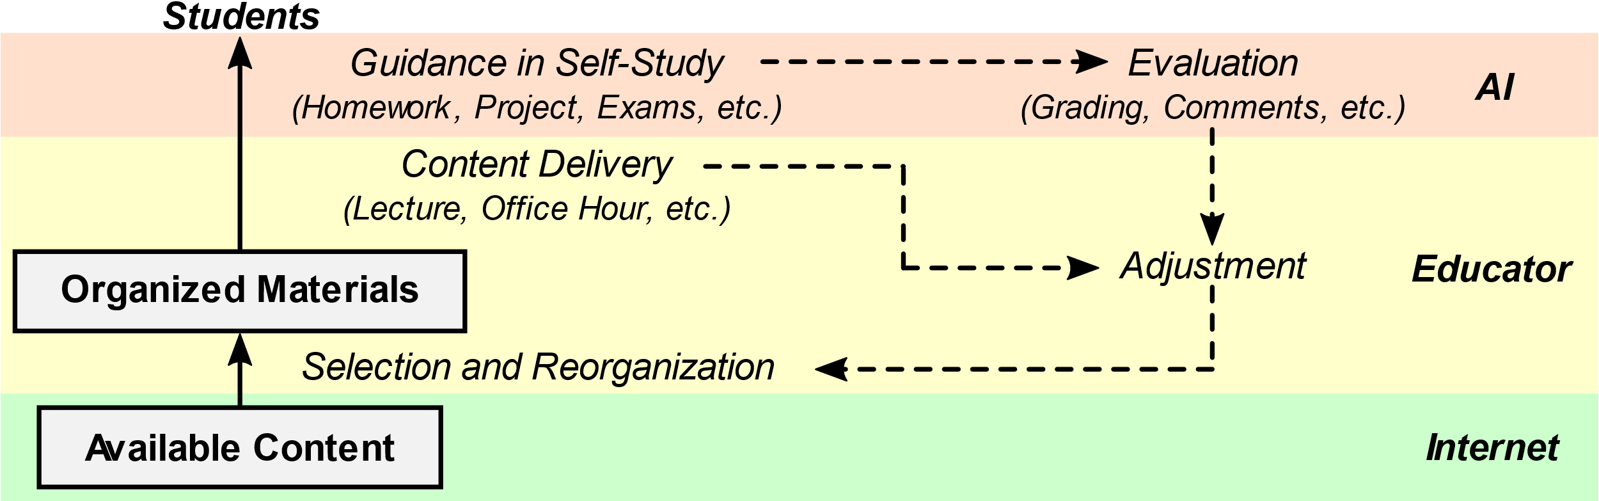
Tailoring game design techniques:
Opportunities and challenges
Reusability
Create high-quality content once
Evaluation automation
Ideally with feedback
Easier for coding assignments
132

Slide 133
Selected game design techniques
Flow (as a rough guideline)
Progress control
Challenges
Intuitive visual hints
Make the learning experience effortless
Reduce effort/cost in fetching study materials
“Let’s be do whatever we can to make games fun!”
133
Notes:
I would like to highlight again that modern game design is a mature industry. They use everything they know of to achieve their goal.
As a results, you can always expect to observe a mixture of techniques.

Slide 134
Not “gamifying”…
More like “sugar coating”
Provide positive feedback on the side
Out of the “learning” process
Decrease the operations that may hurt the motivation
Reduce cost in information fetching
134

Slide 135
Example pay-as-you-go program framework
For a specific program, we could pre-define a few skills we want to teach. They would serve as module (tree node) groups.
Then, we could add relevant online courses into each module group to teach the corresponding skill.
Courses can be purchased and studied individually (hence, "pay as you go").
The key is that, for each course, we could list alternative versions/flavors of the same course, e.g., with different years, instructors, and/or teaching materials, so that students have the opportunity to customize the program by selecting their preferred versions.
We could have one or two free-trial lectures in each course to facilitate the decision.
We could also design a course evaluation system for participating students to comment on/rate courses that they finished.
135
Notes:
Empty/template slide.

Slide 136
Benefits of this framework
Motivating professors to contribute to online education
We could distribute part of the profit from a course to its instructor as an incentive, ideally as a percentage of the profit rather than a fixed base amount.
If a star professor becomes rich from their online courses, that will be a great example for us to brag about to persuade other professors to participate.
Granting students the option of choosing from different flavors of the same course would promote healthy competition among instructors.
Instructors who participate early (e.g., when their courses are essentially the only options) or who can provide higher-quality teaching (e.g., to win the market against multiple competing versions of the same course) will earn the most money.
136
Notes:
Empty/template slide.

Slide 137
A student-oriented course evaluation system
The same student performance evaluations (e.g., exams) could be used in the different versions of the same course.
Courses with the best student performance => Potential sources for better practices in online education
Easy feedback from market/students (Ref: Amazon.com)
Most profitable courses, or highly-rated courses with positive comments => Potential versions to promote
Motivating students to progress in courses
We could allow students to buy new courses with points they earn from completed courses.
This would increase the "illusional scarcity" of points to better motivate students to progress in purchased courses.
We could use other virtual currencies we come up with for this purpose, so that students are still willing to spend points for less valuable resources like hints.
The average amount of virtual currency a student can get needs to be carefully planned for the trade-off between student motivation and program profit.
137
Notes:
Empty/template slide.

Slide 138
More flexible payment
(Traditional) One-time payment plan
Wholesale price for all required courses to get a degree/finish a program should be cheaper than other options, even with the virtual currency considered.
(Pay-as-you-go) Buy and take courses one by one
A program could enforce an "expiration date" of a course certificate if the student wants to use that for a degree/to complete that program.
138
Notes:
Empty/template slide.

Slide 139
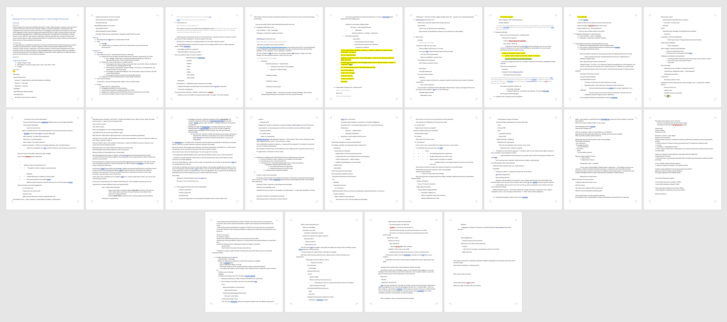
22 pages of outline
139
Notes:
Empty/template slide.

